Slide 1
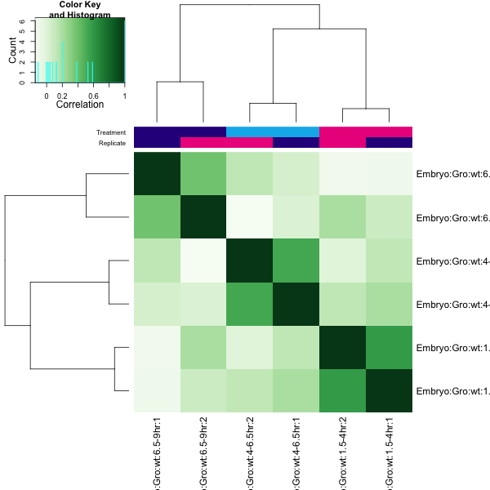
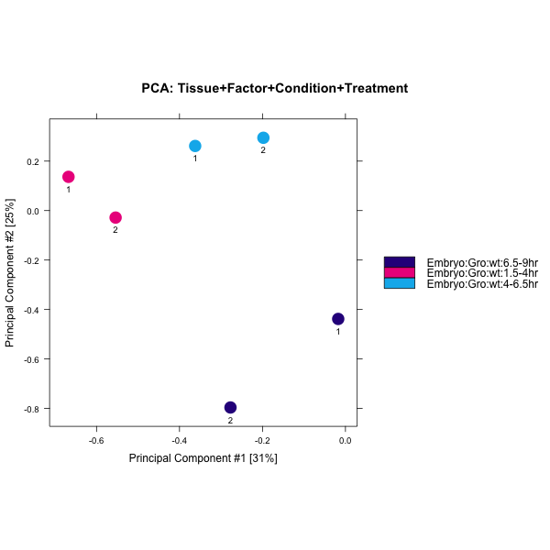
Fig. 2-1
A
B
C

Slide 2
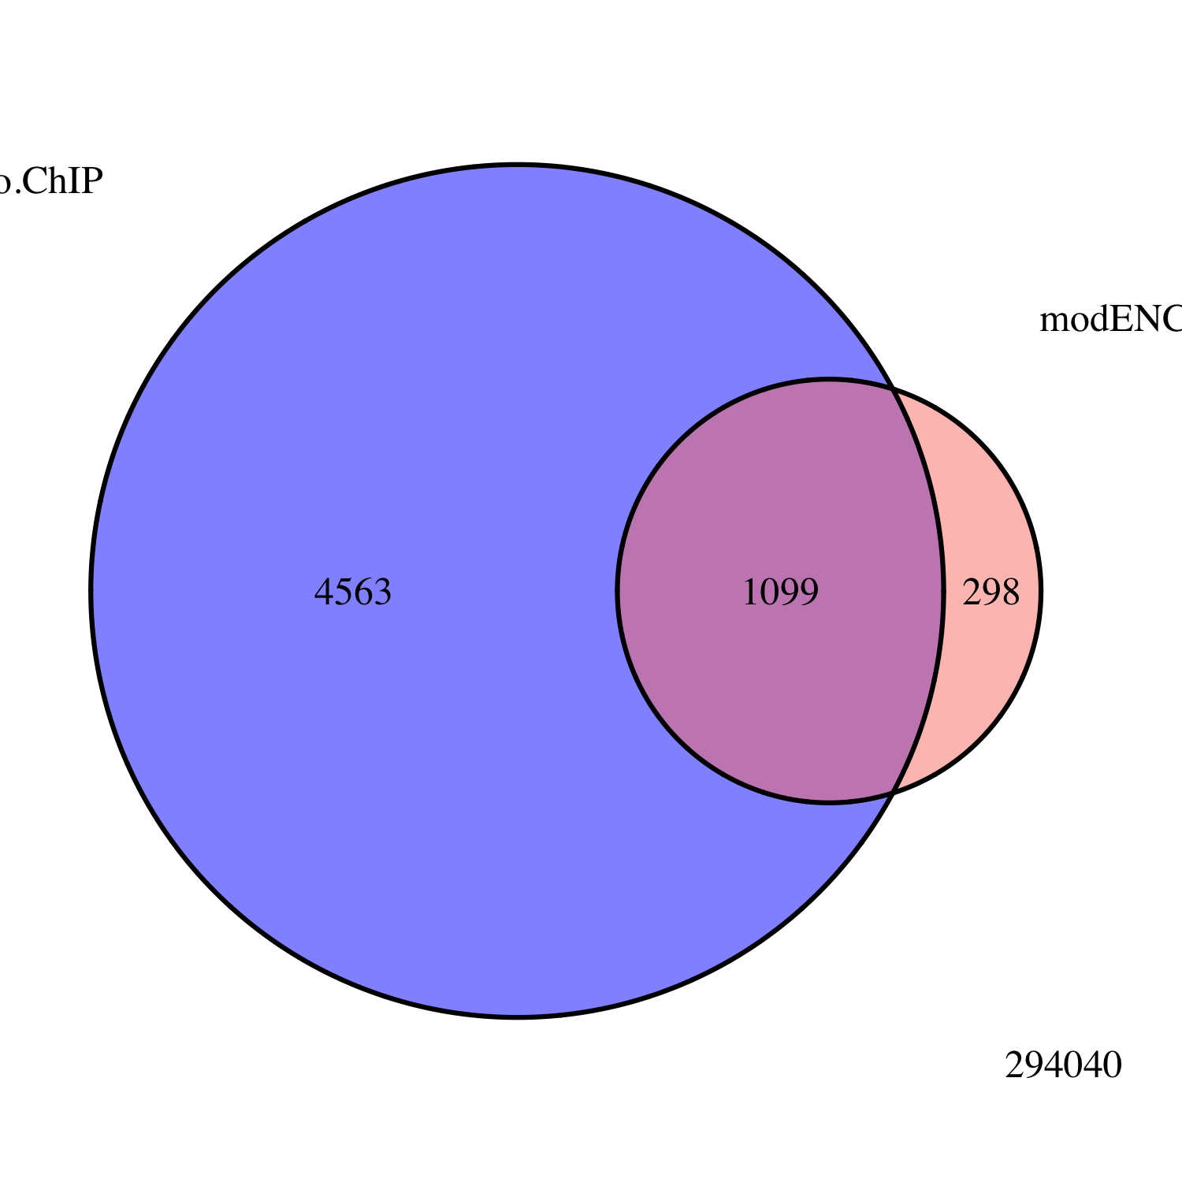
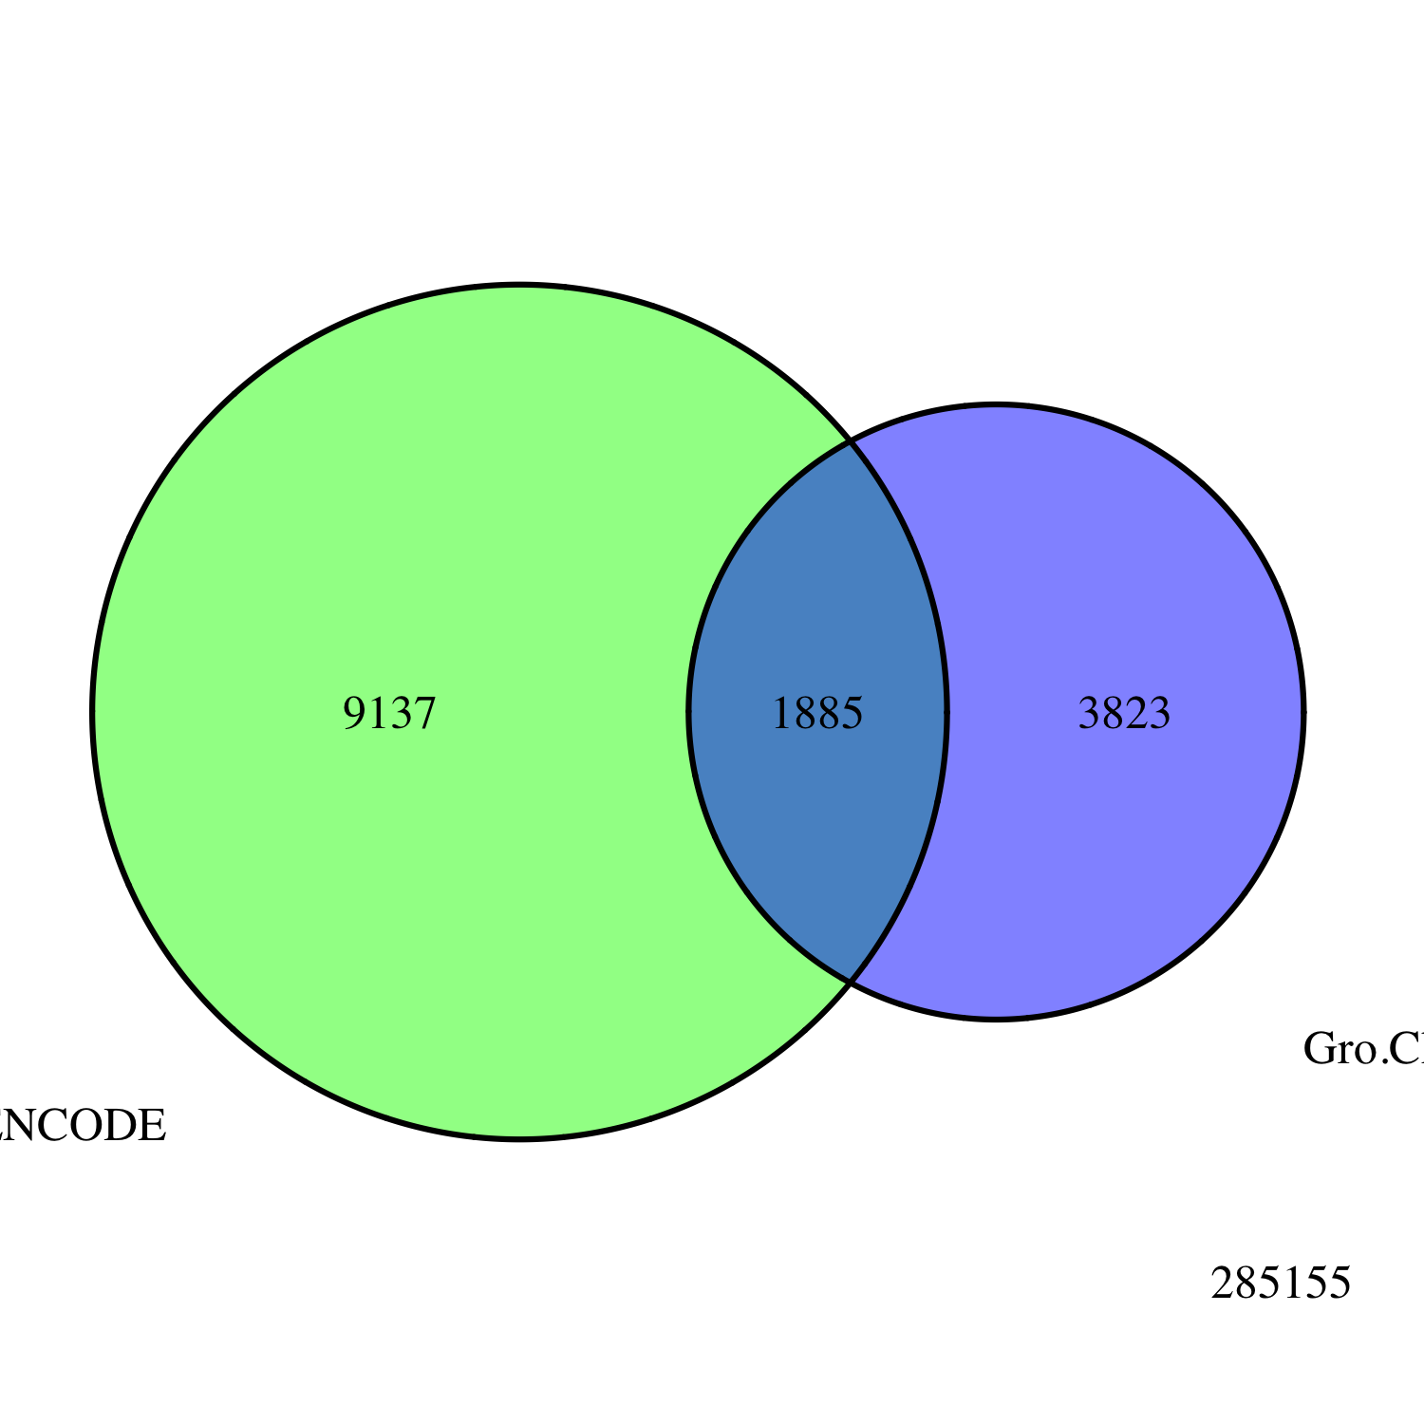
Fig. 2-2
Embryo
Gro ChIP-seq
All Peaks
modENCODE
Embryo
Gro ChIP-chip
Embryo
Gro ChIP
All Peaks
3823
modENCODE
White Pre-Pupae
Gro ChIP-chip
1885
9137

Slide 3
Fig. 2-5
A
B

Slide 4
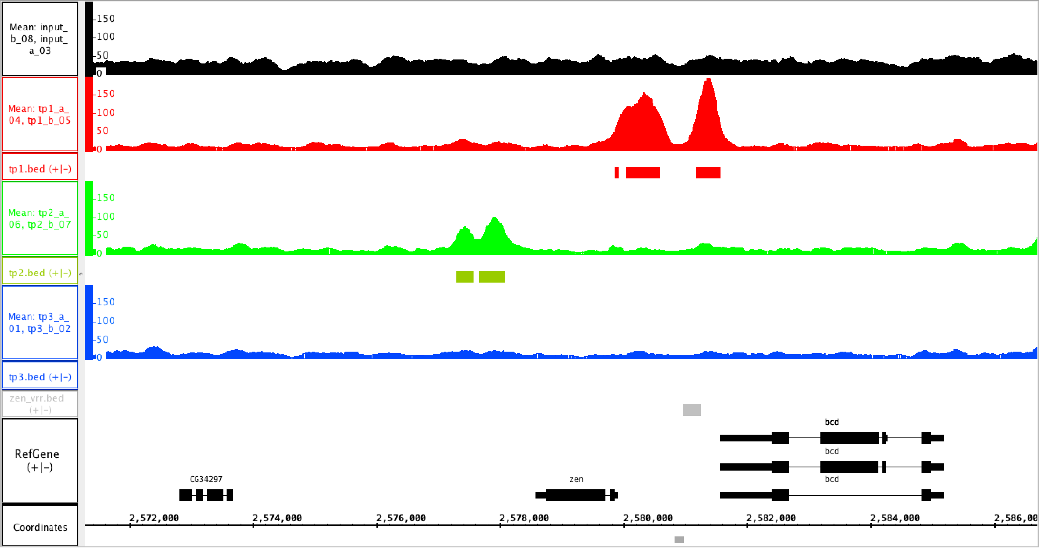
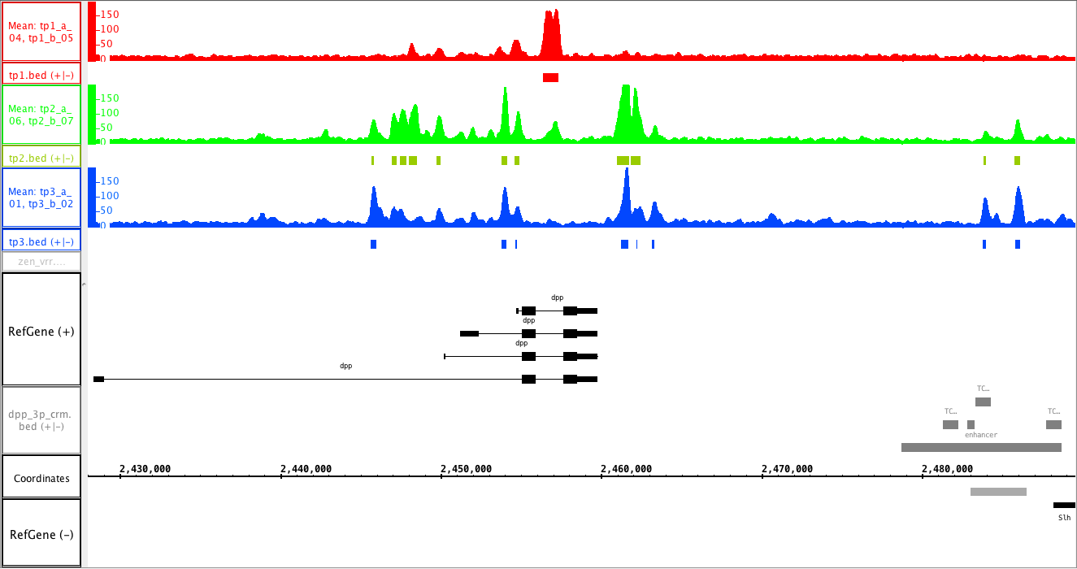
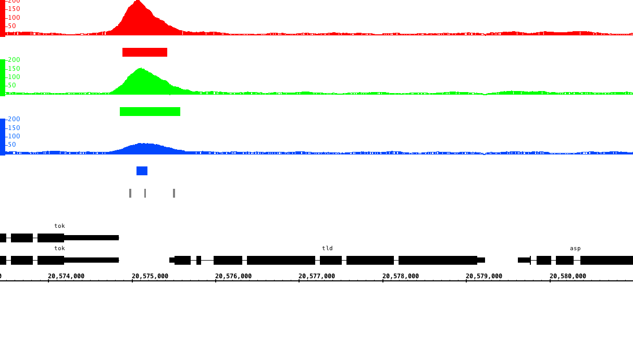
Fig. 2-6
A
1.5 – 4 hr
4 – 6.5 hr
6.5 – 9 hr
VRR
B
1.5 – 4 hr
4 – 6.5 hr
6.5 – 9 hr
C
1.5 – 4 hr
4 – 6.5 hr
6.5 – 9 hr
Dorsal binding sites

Slide 5
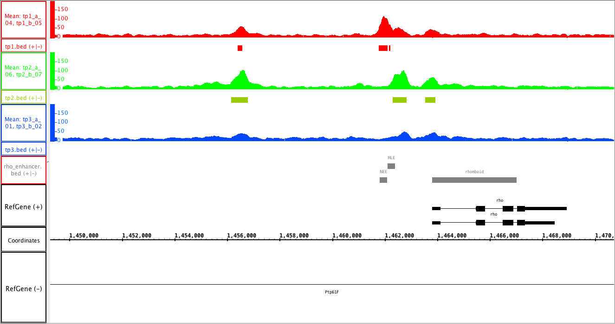
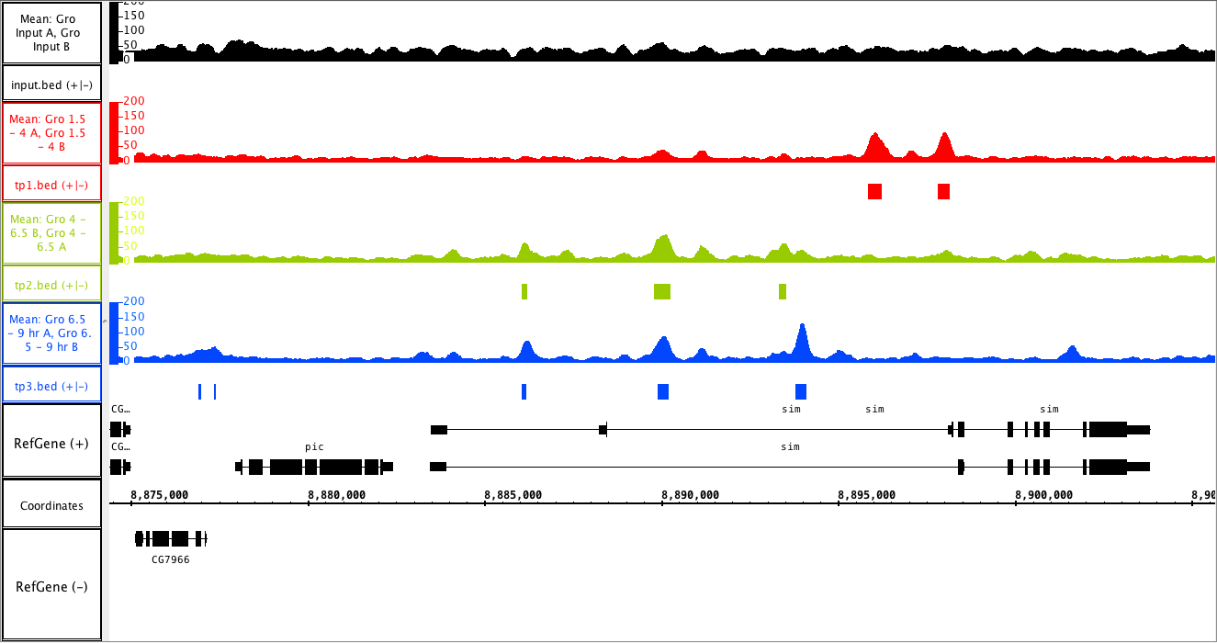
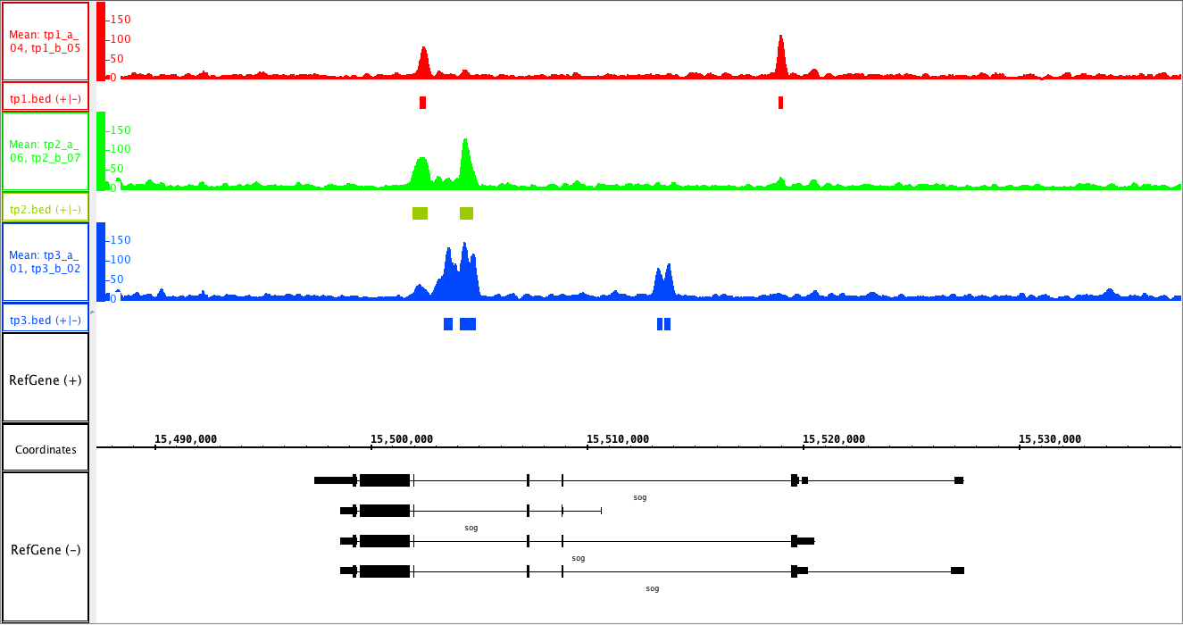
Fig. 2-7
A
1.5 – 4 hr
4 – 6.5 hr
6.5 – 9 hr
B
1.5 – 4 hr
4 – 6.5 hr
6.5 – 9 hr
C
1.5 – 4 hr
4 – 6.5 hr
6.5 – 9 hr

Slide 6
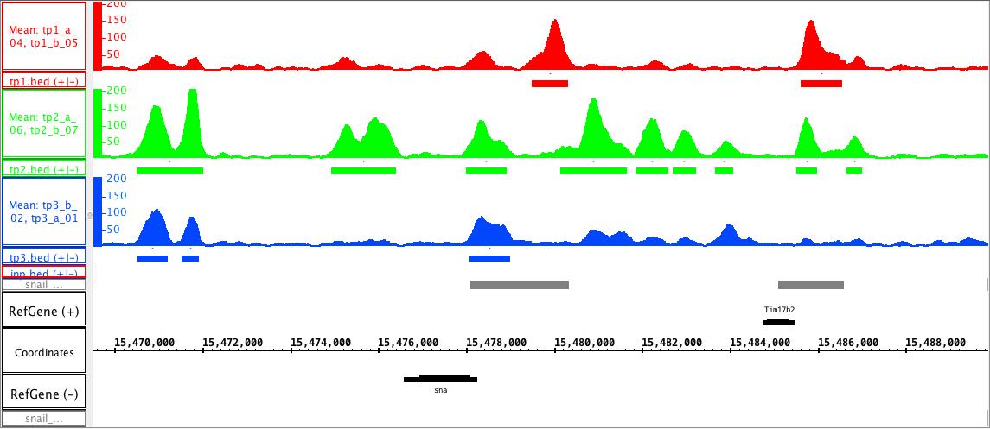
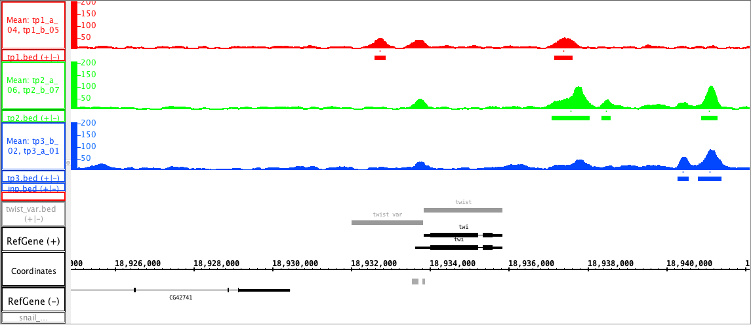
Fig. 2-
A
1.5 – 4 hr
4 – 6.5 hr
6.5 – 9 hr
primary
shadow
B
1.5 – 4 hr
4 – 6.5 hr
6.5 – 9 hr
VAR

Slide 7
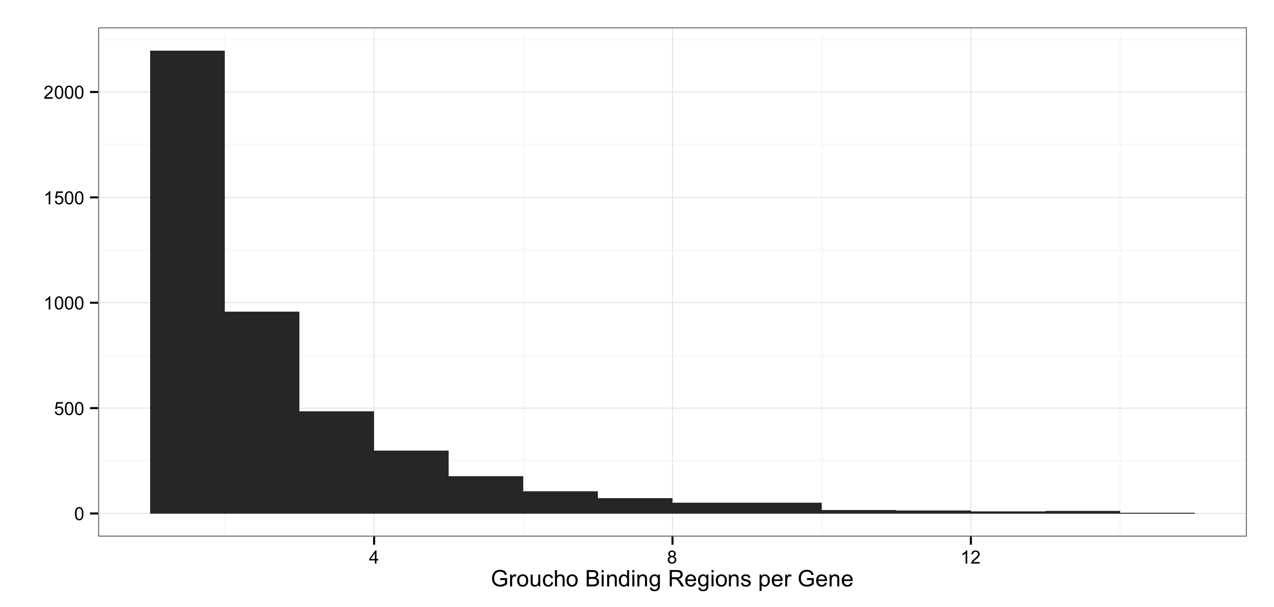
Fig. 2-8
A
B

Slide 8
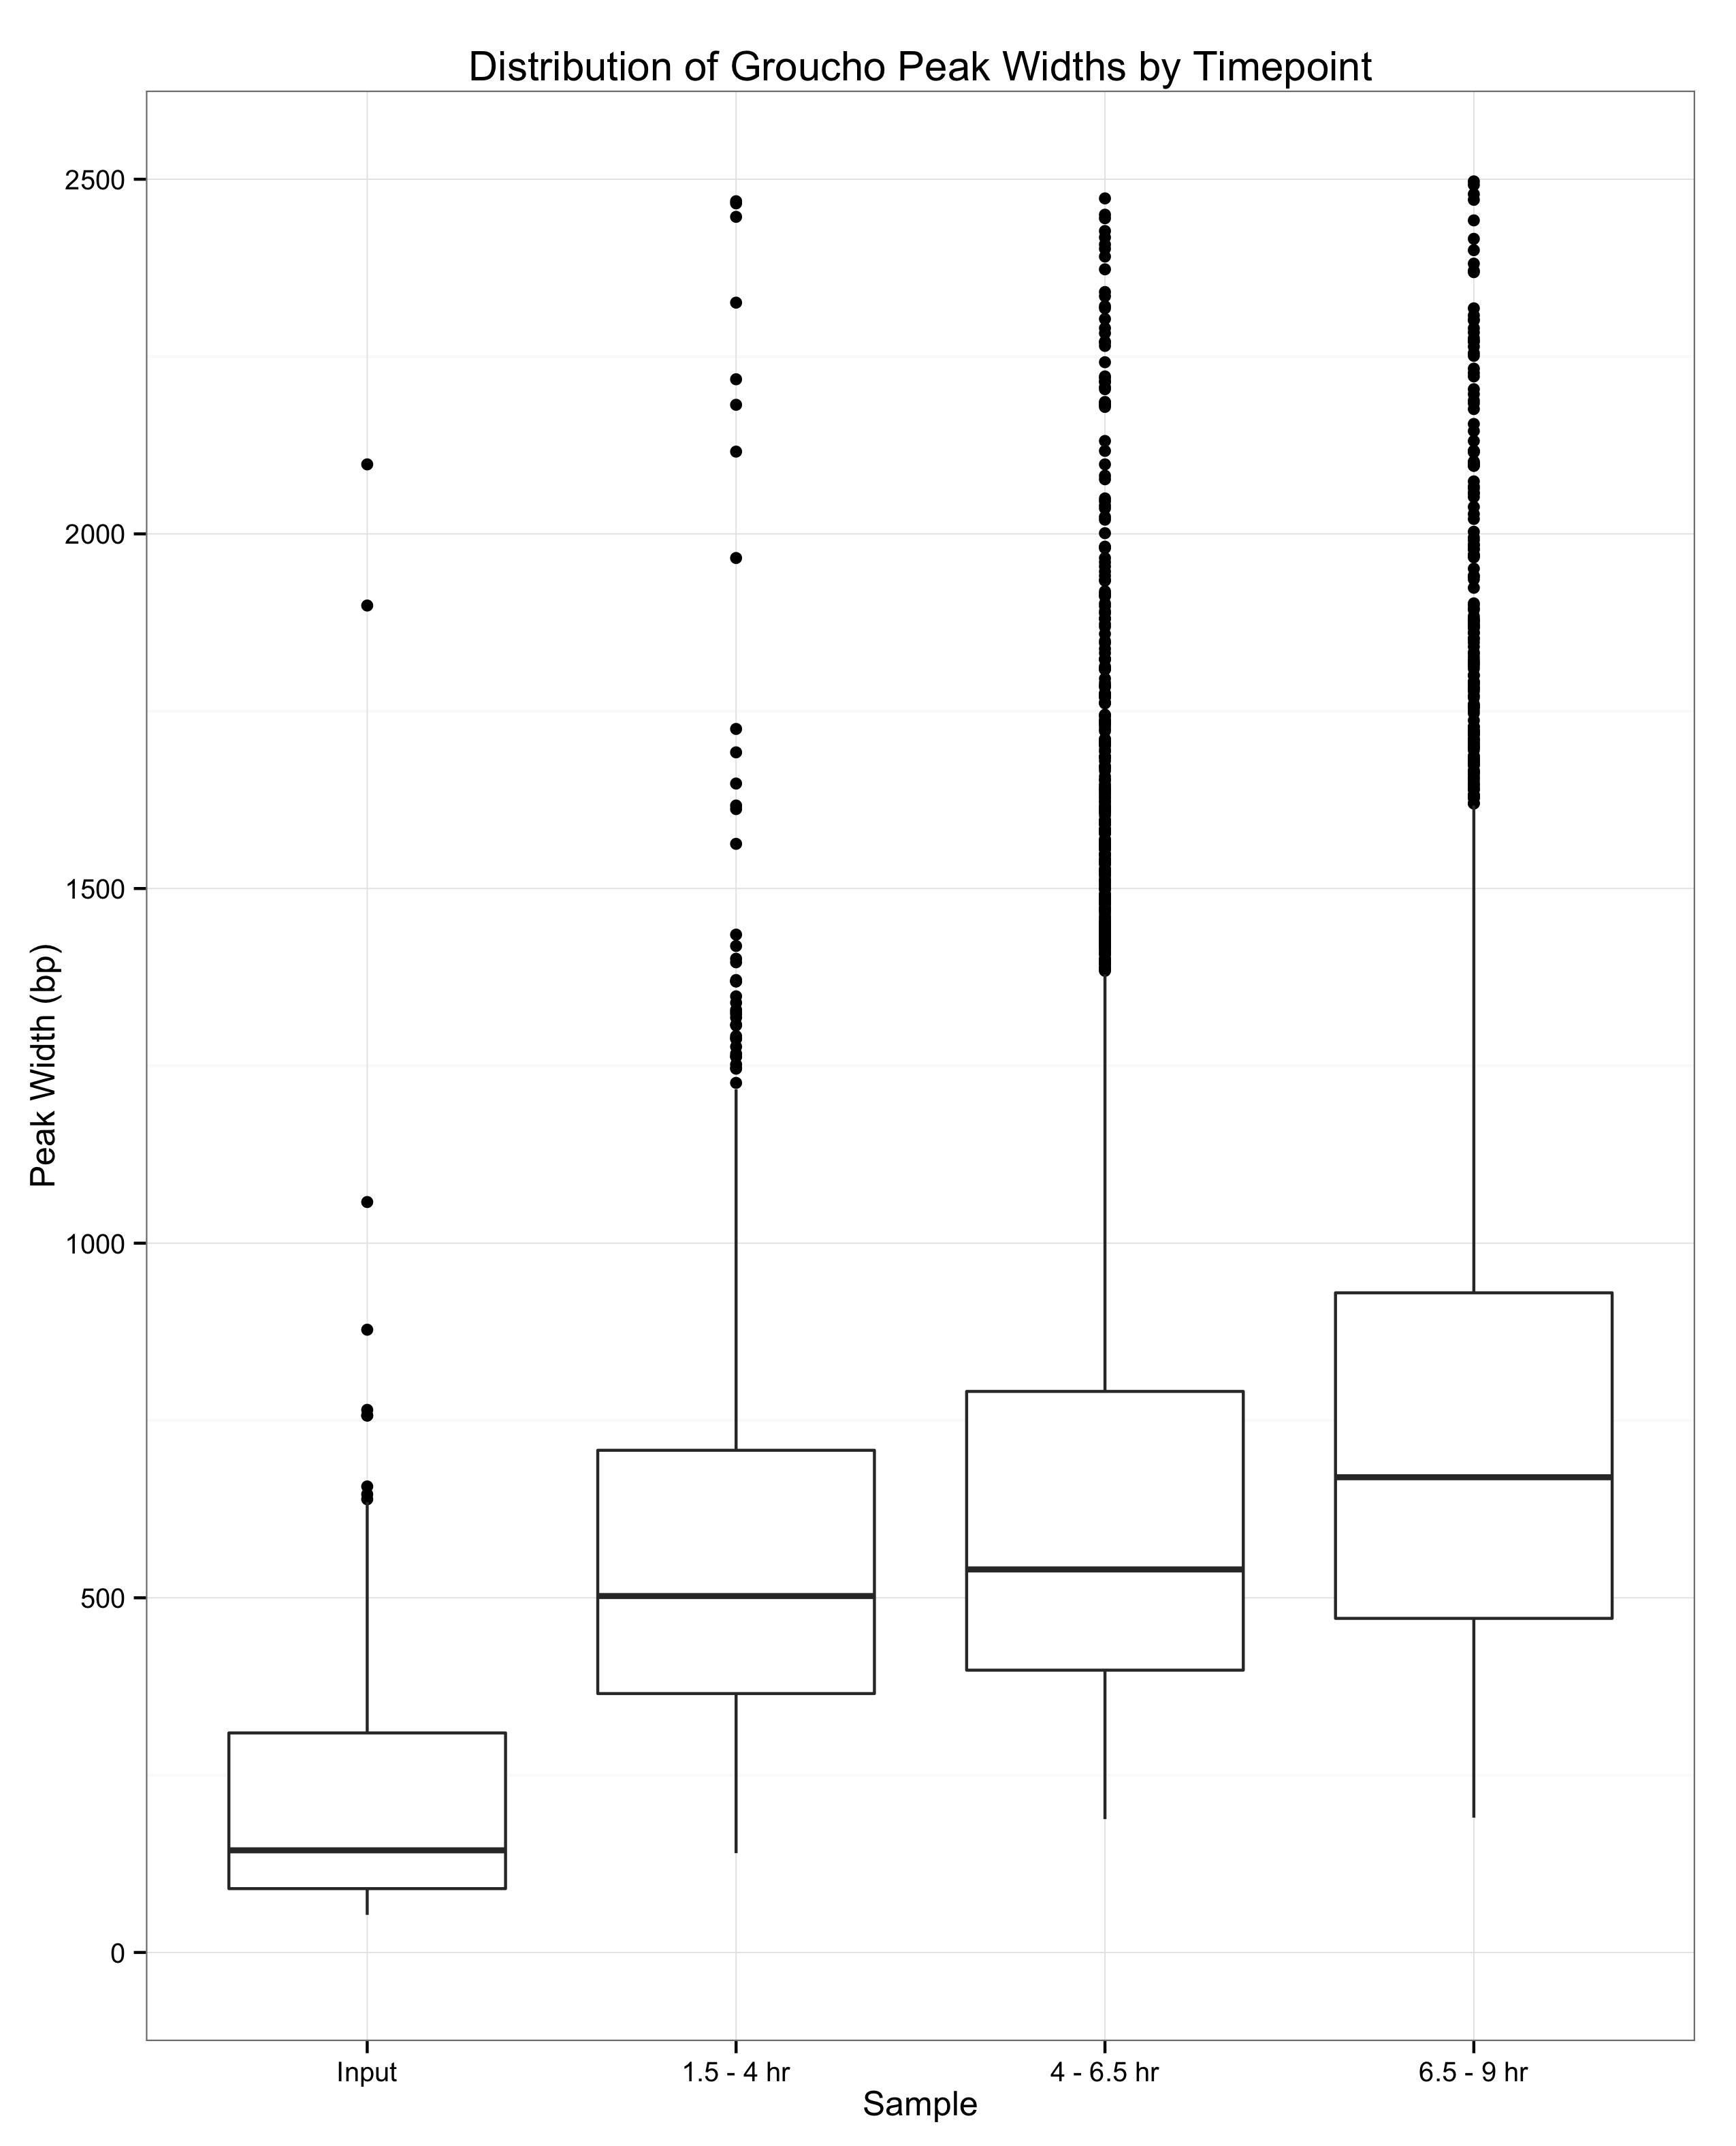
Fig. 2-9

Slide 9
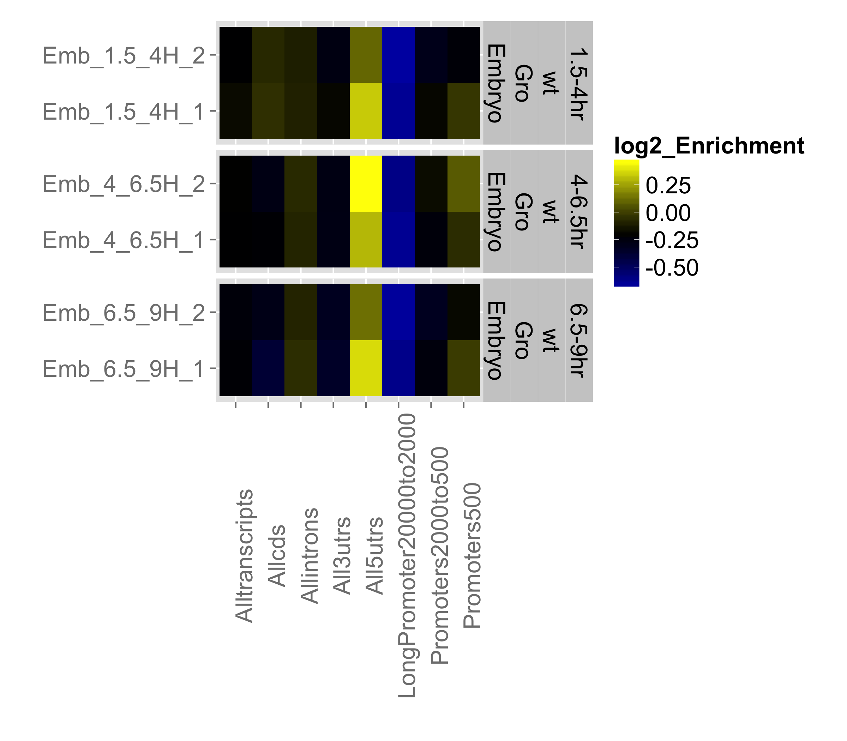
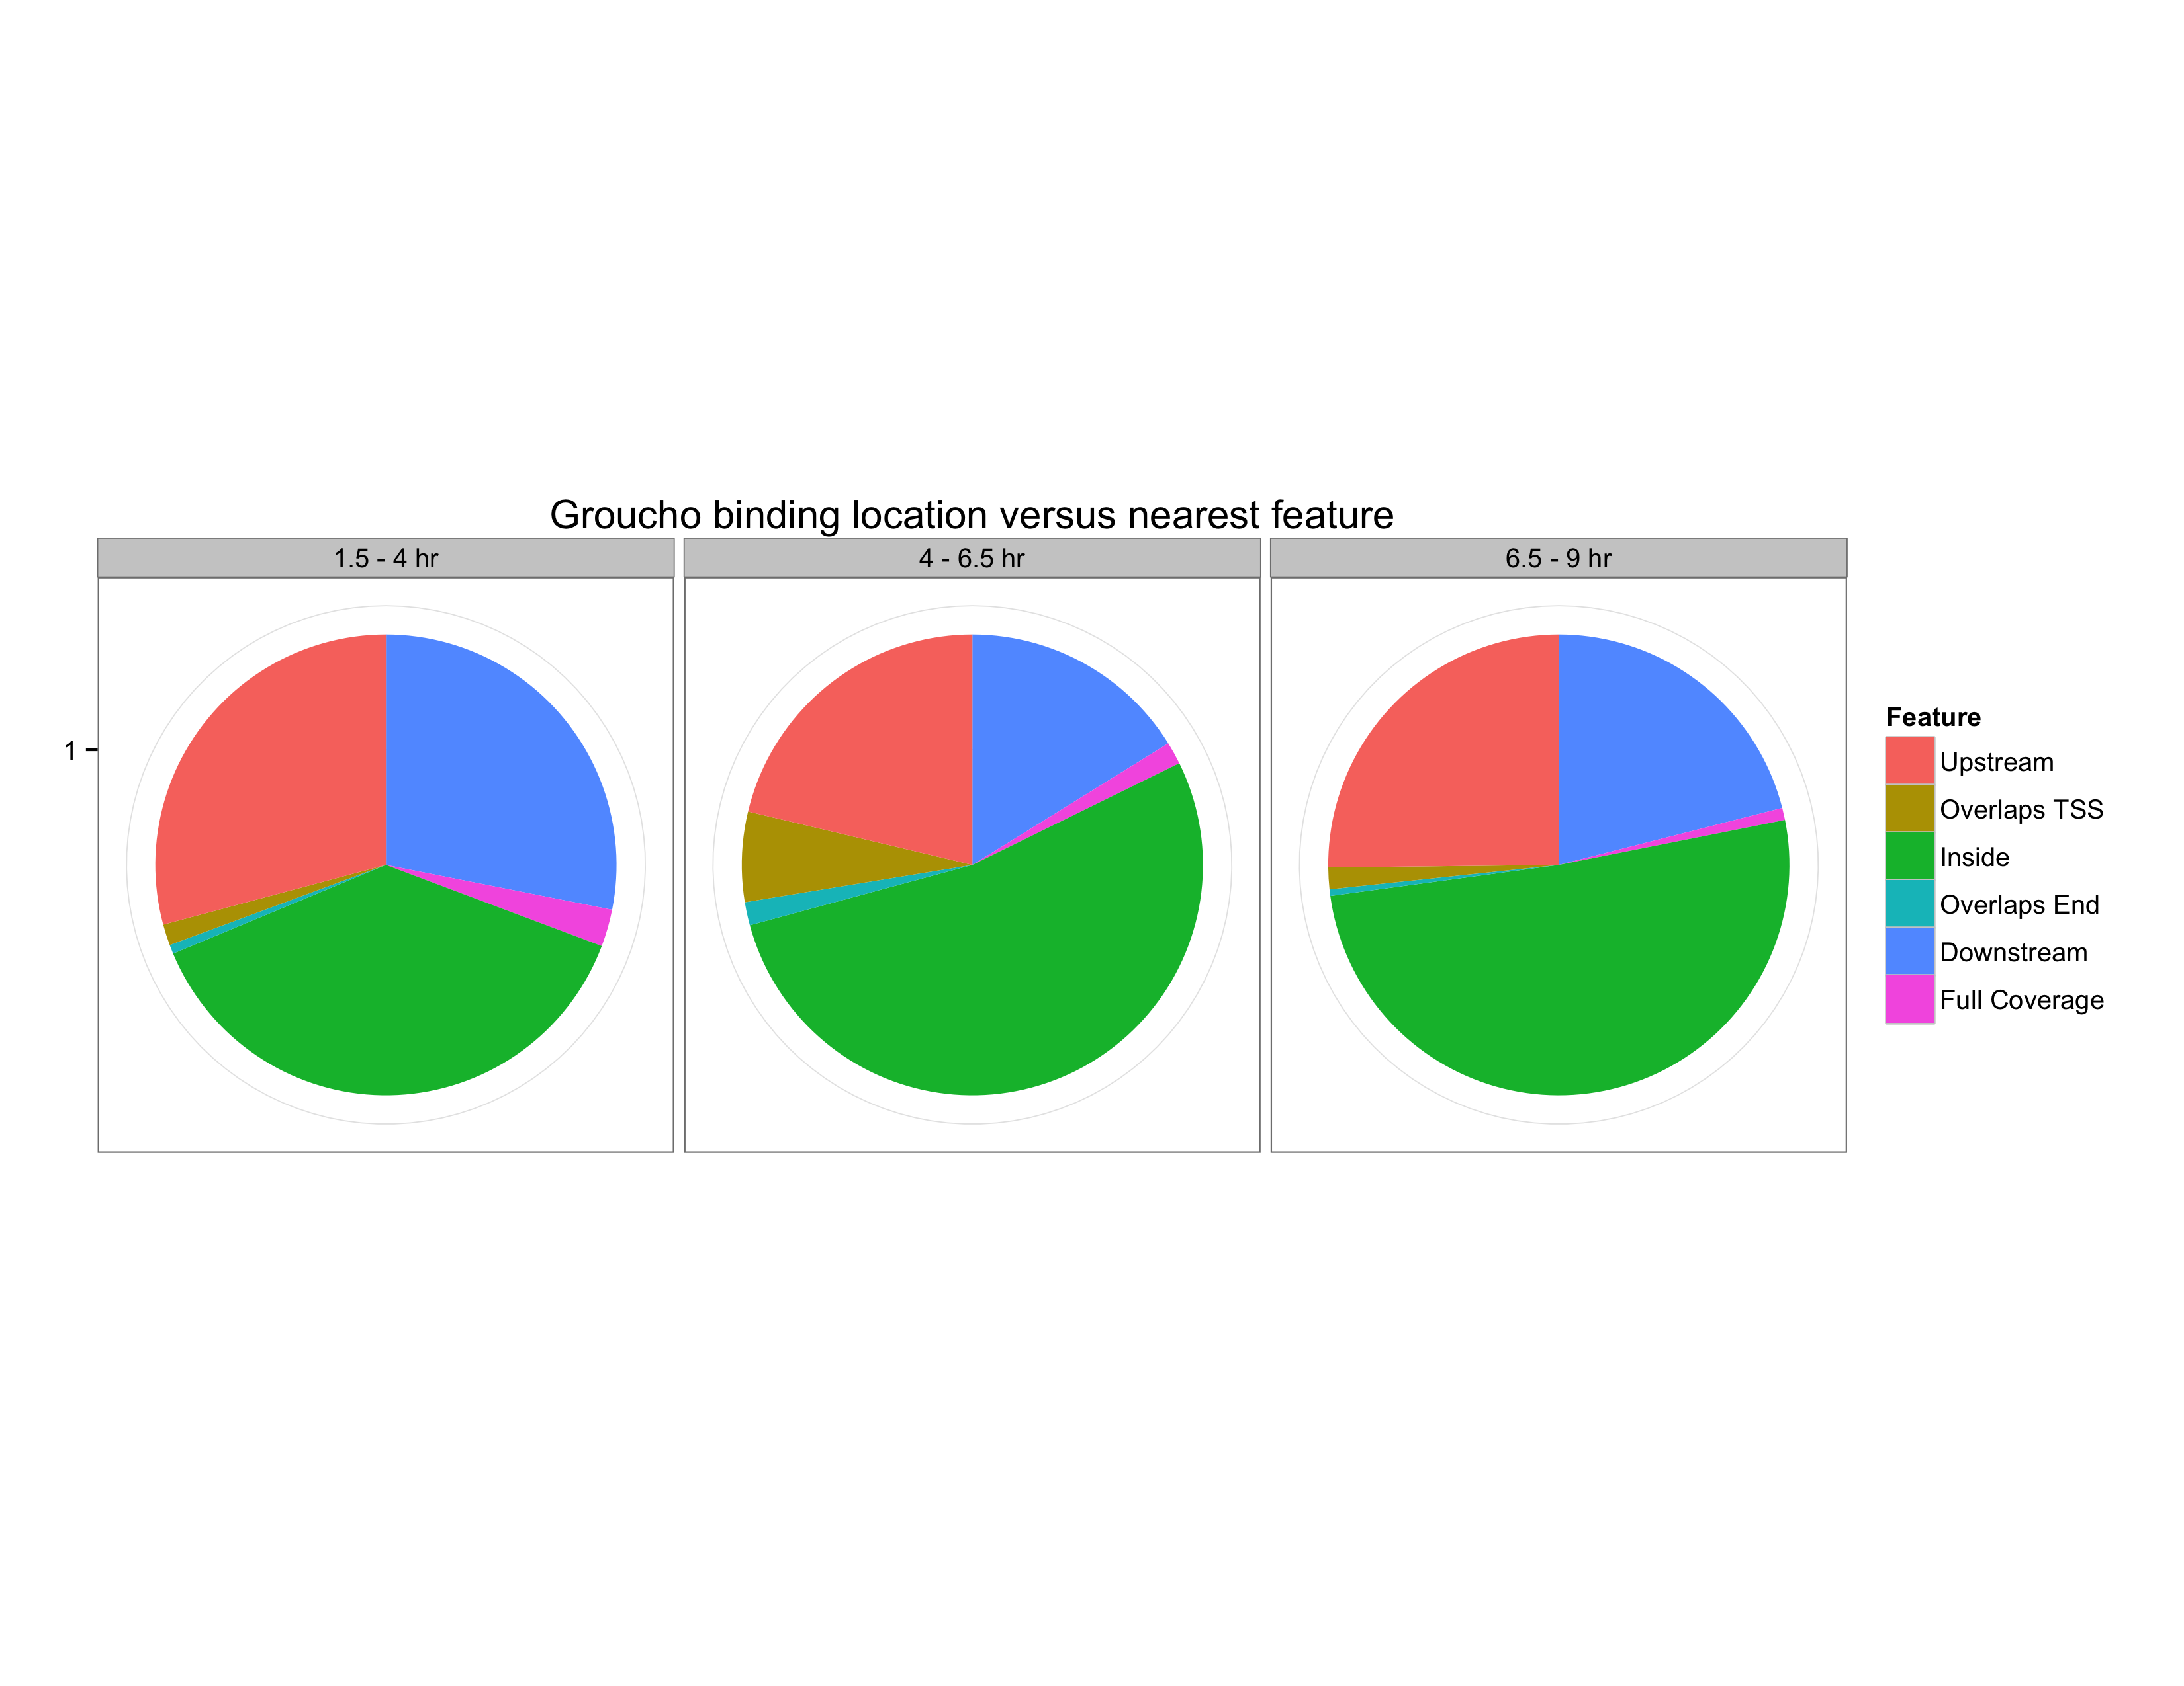
Fig. 2-10
A
B

Slide 10
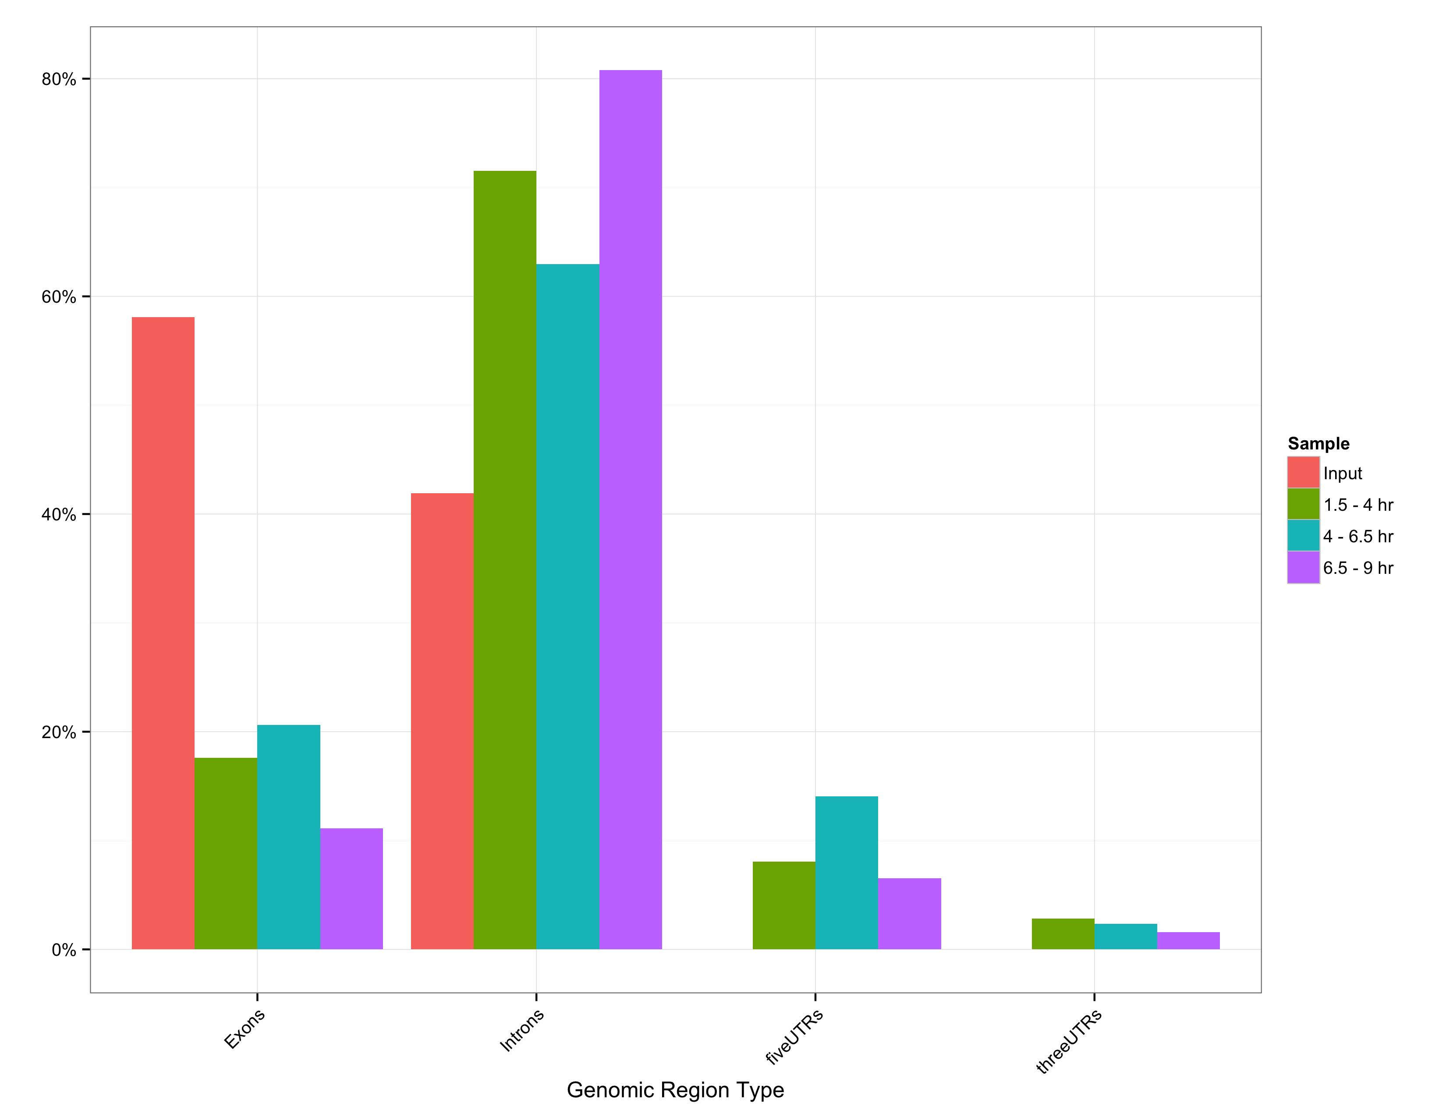
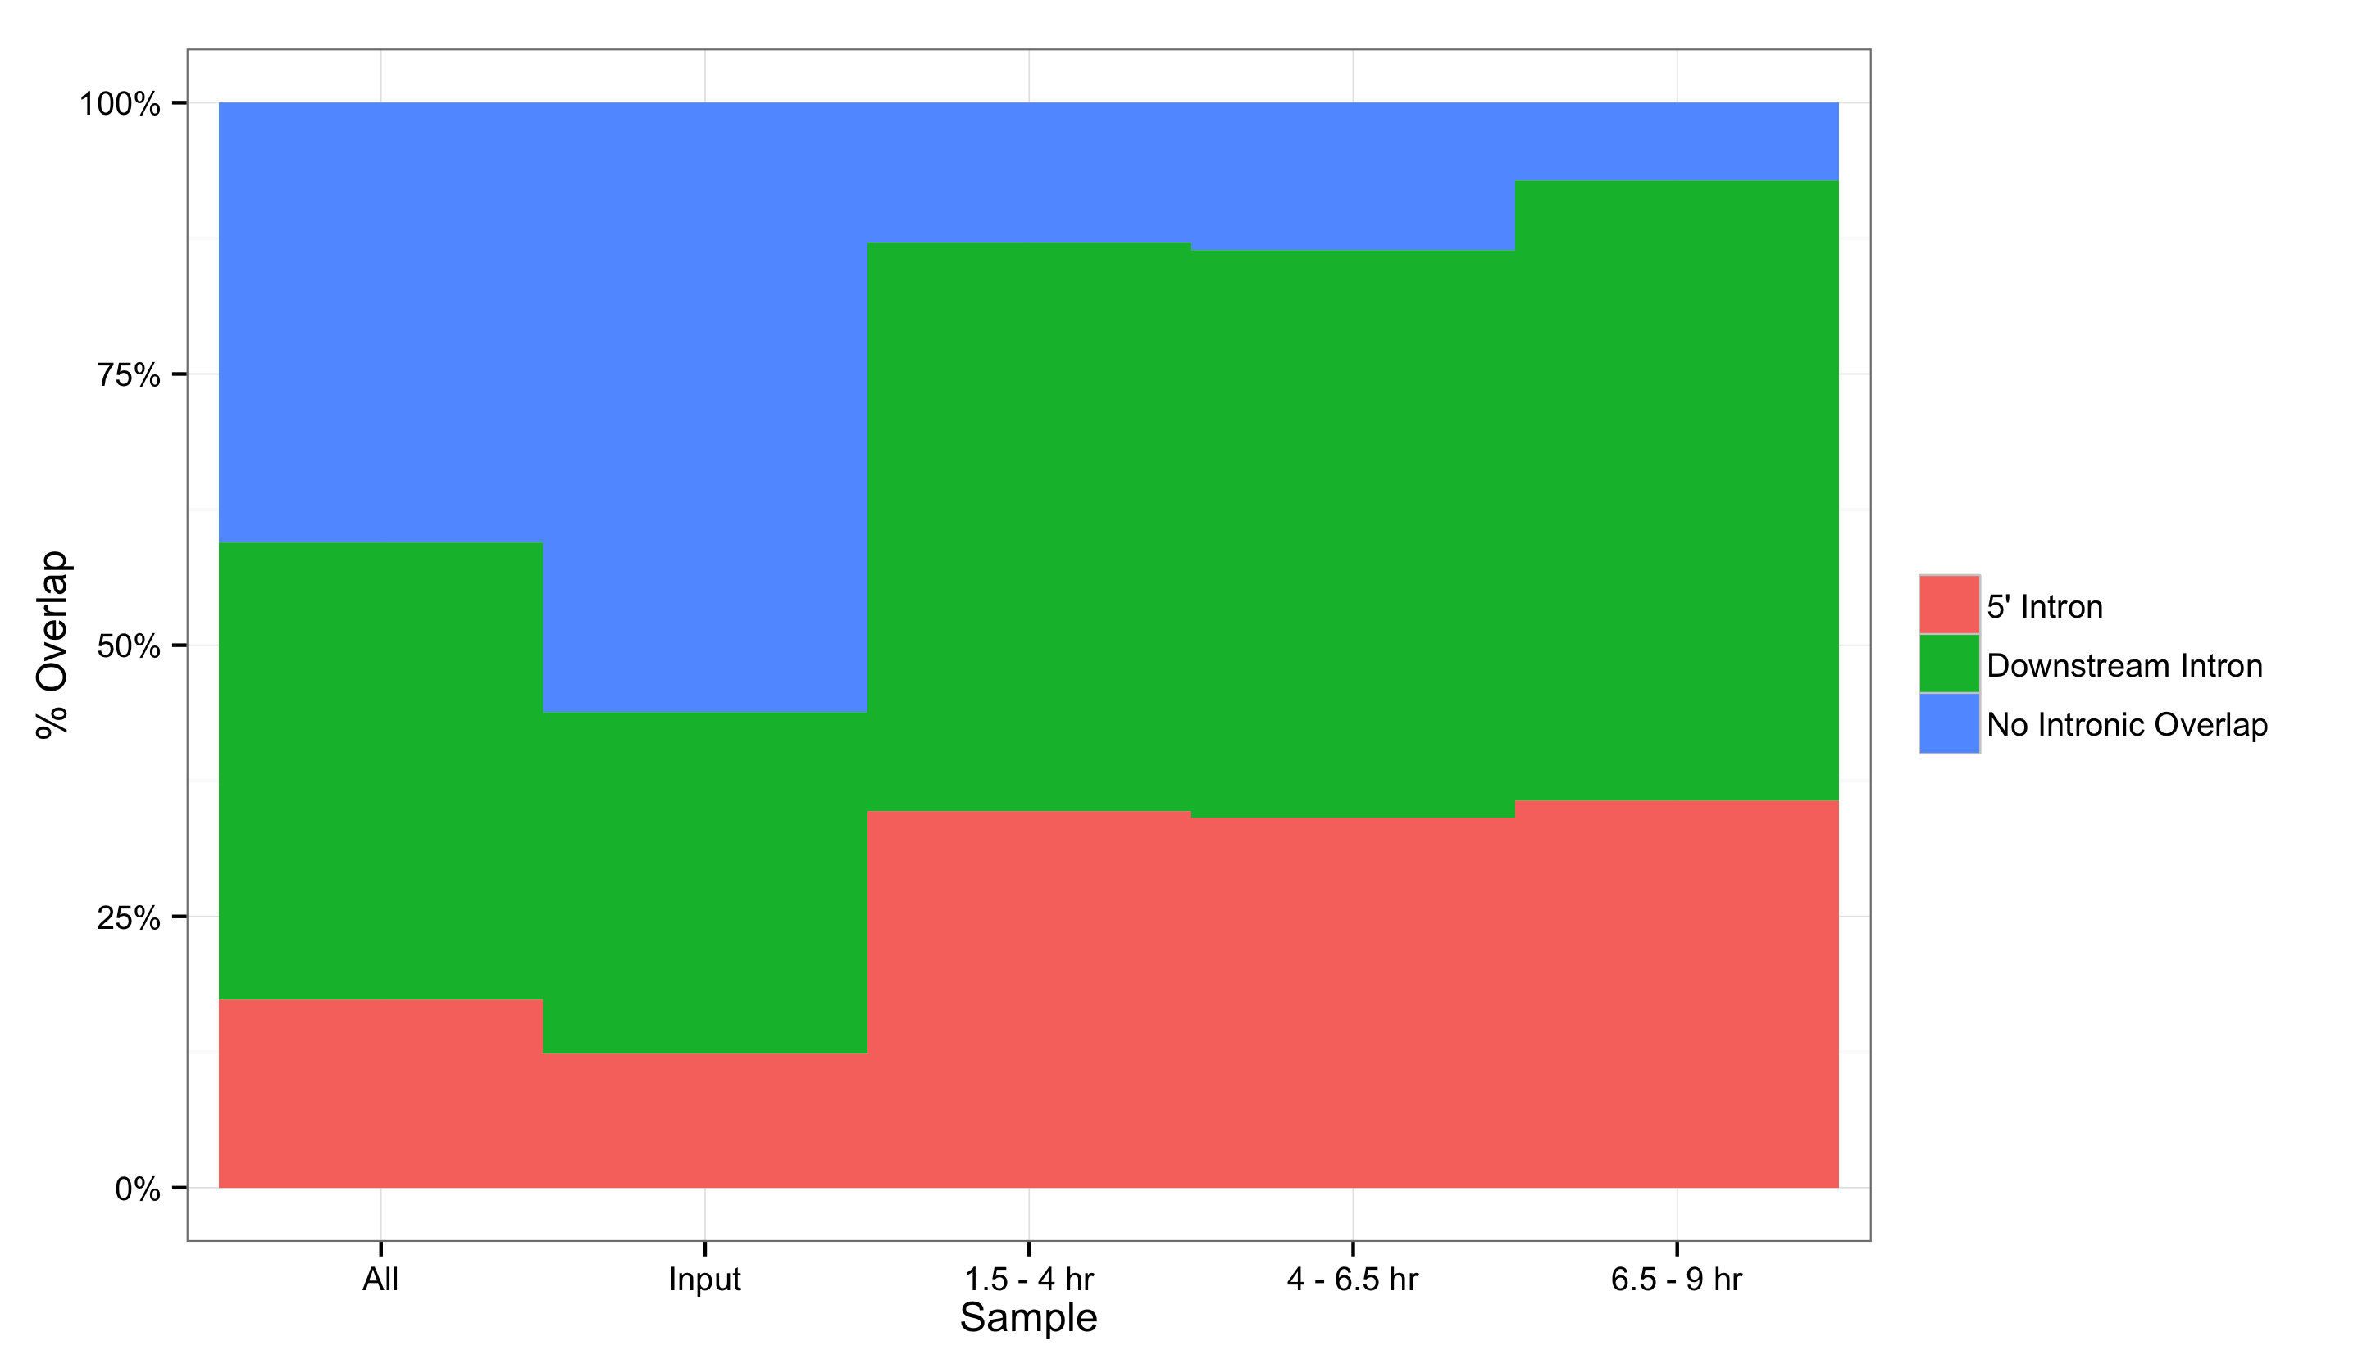
Fig. 2-11
A
B

Slide 11
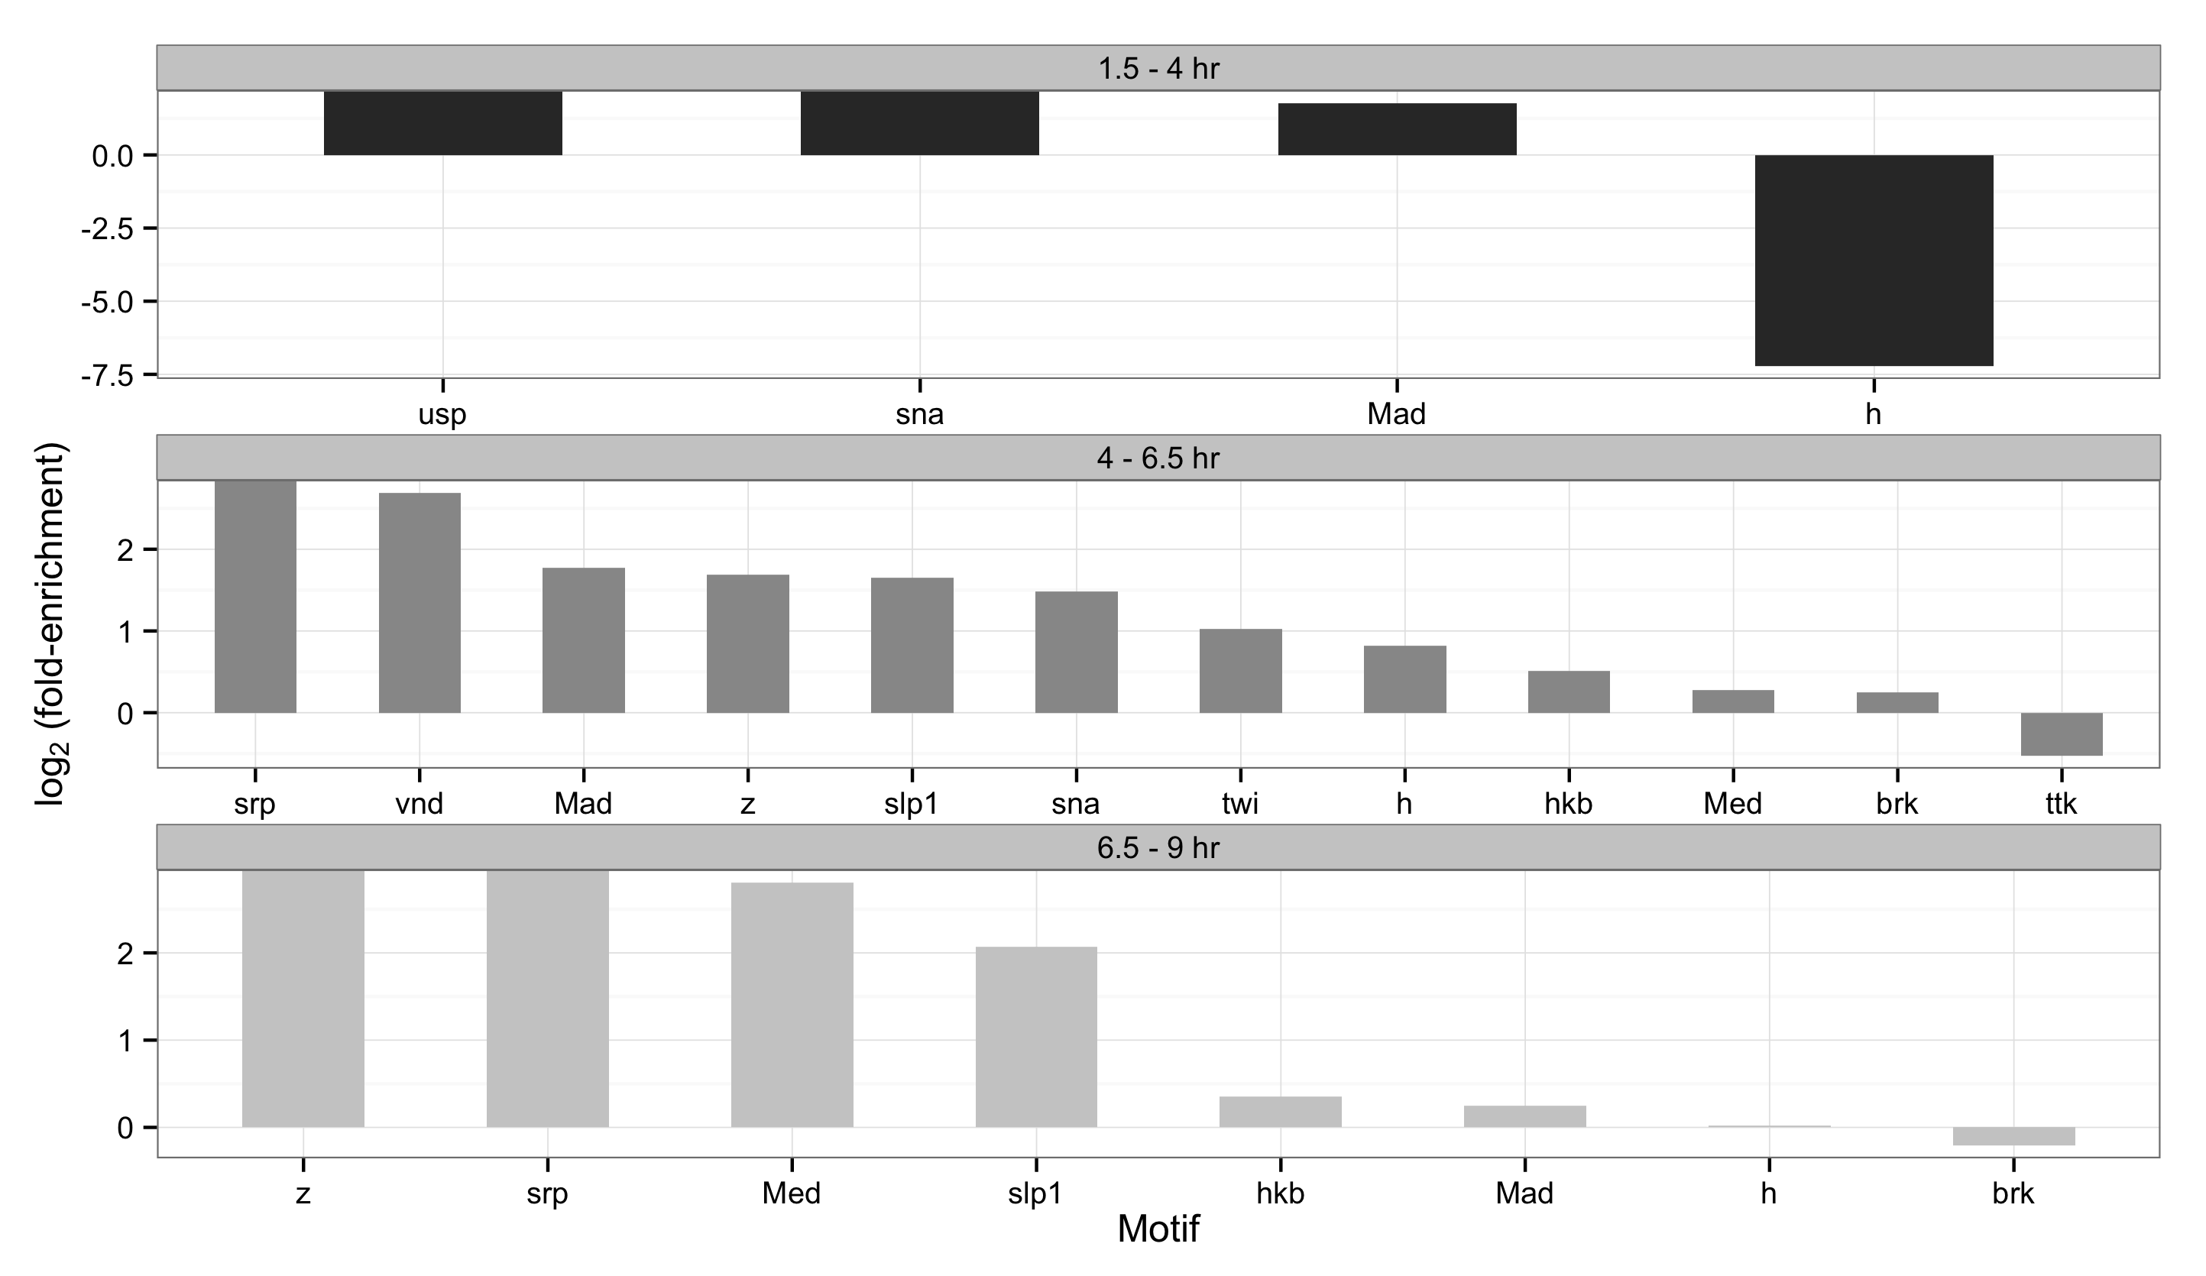
Fig. 2-12

Slide 12
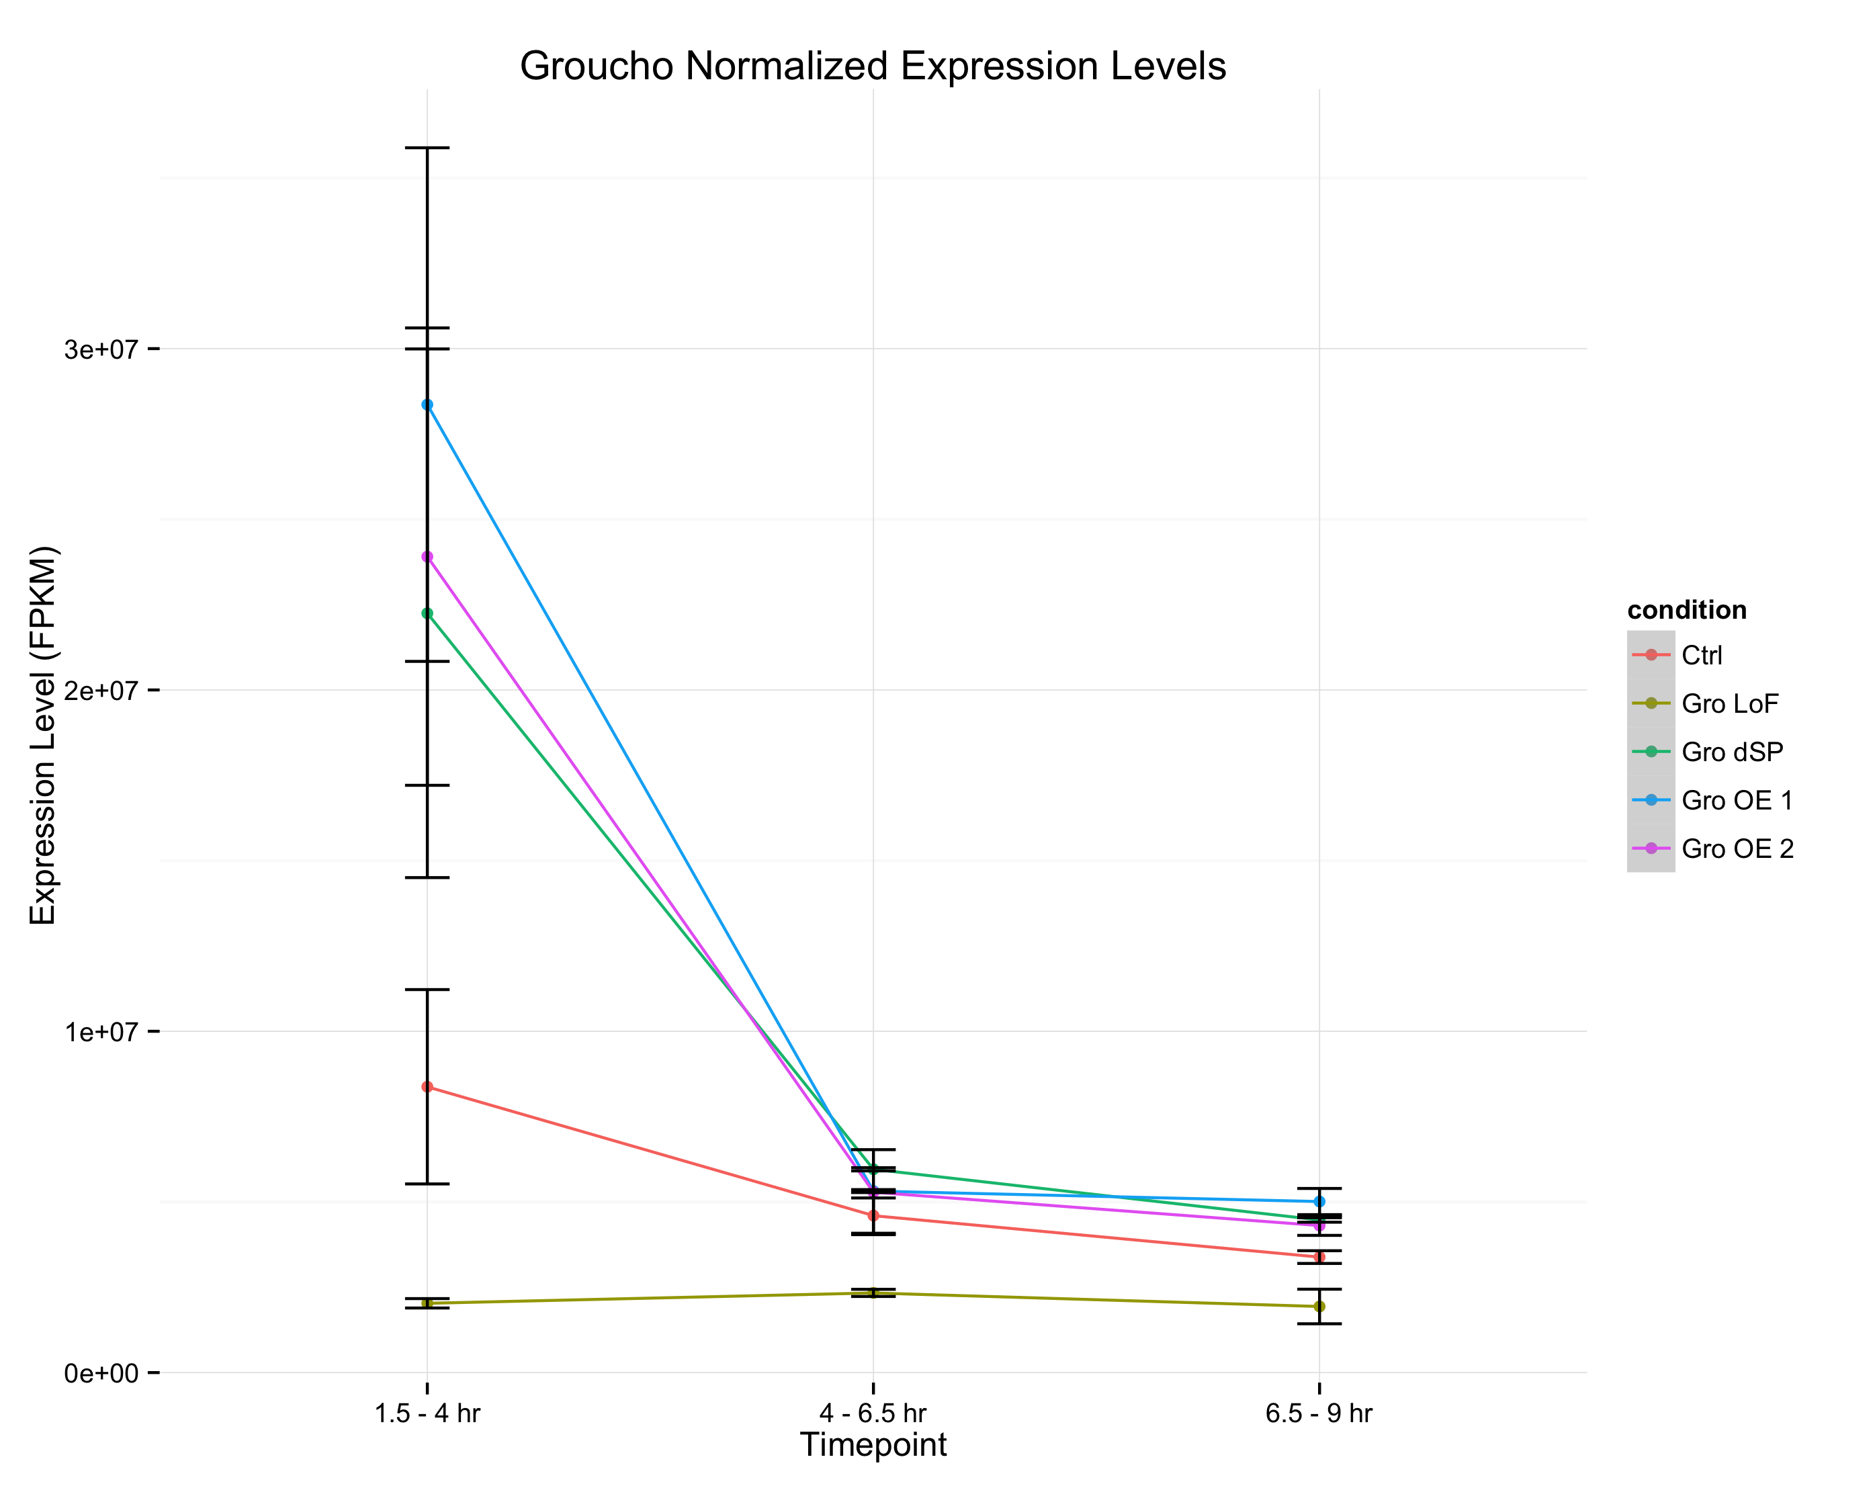
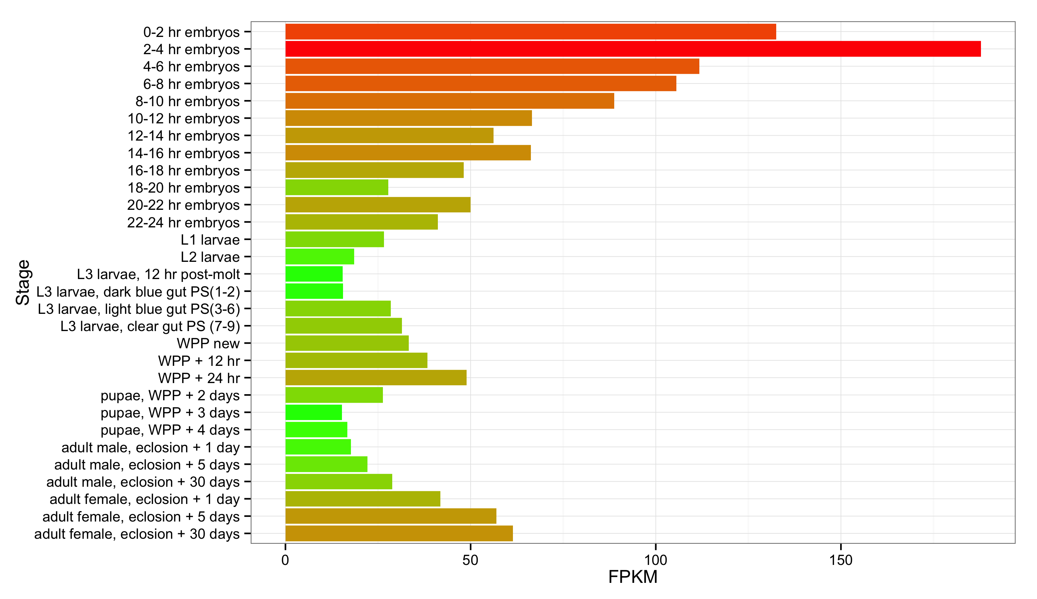
Fig. 2-13
A
Groucho transcript abundance
modENCODE Developmental Transcriptome Project
B

Slide 13
Fig. 2-14

Slide 14
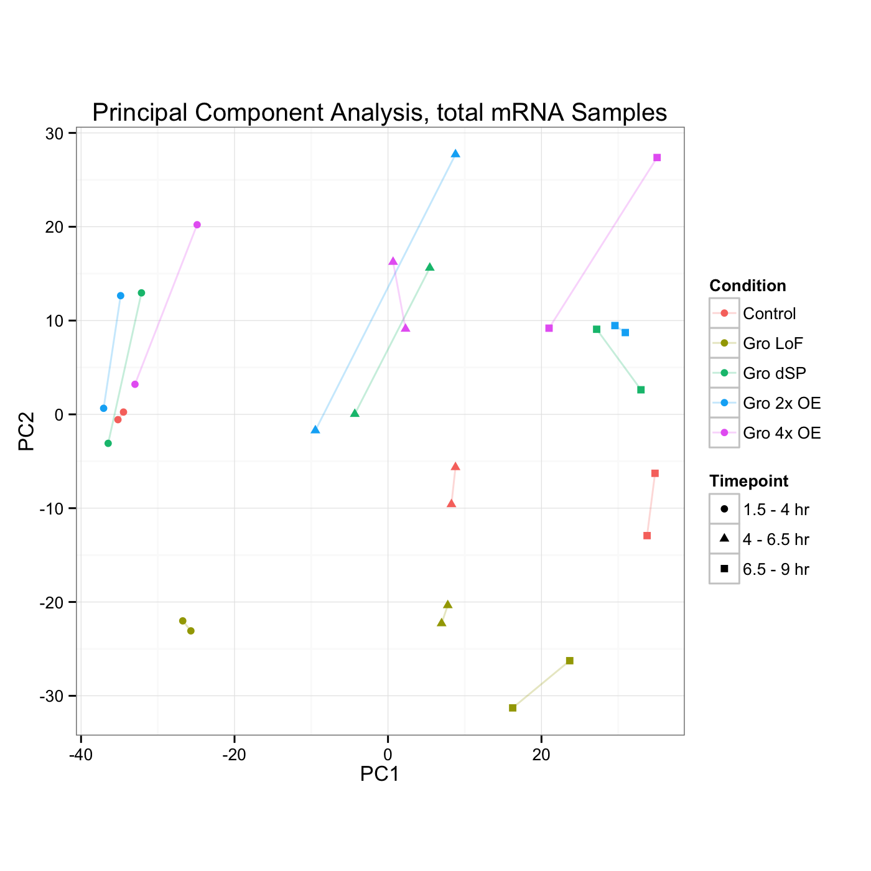
Fig. 2-15
Gro Dosage
Developmental Stage

Slide 15
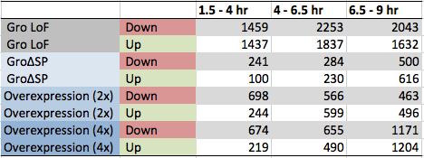
Fig. 2-16
A
B

Slide 16
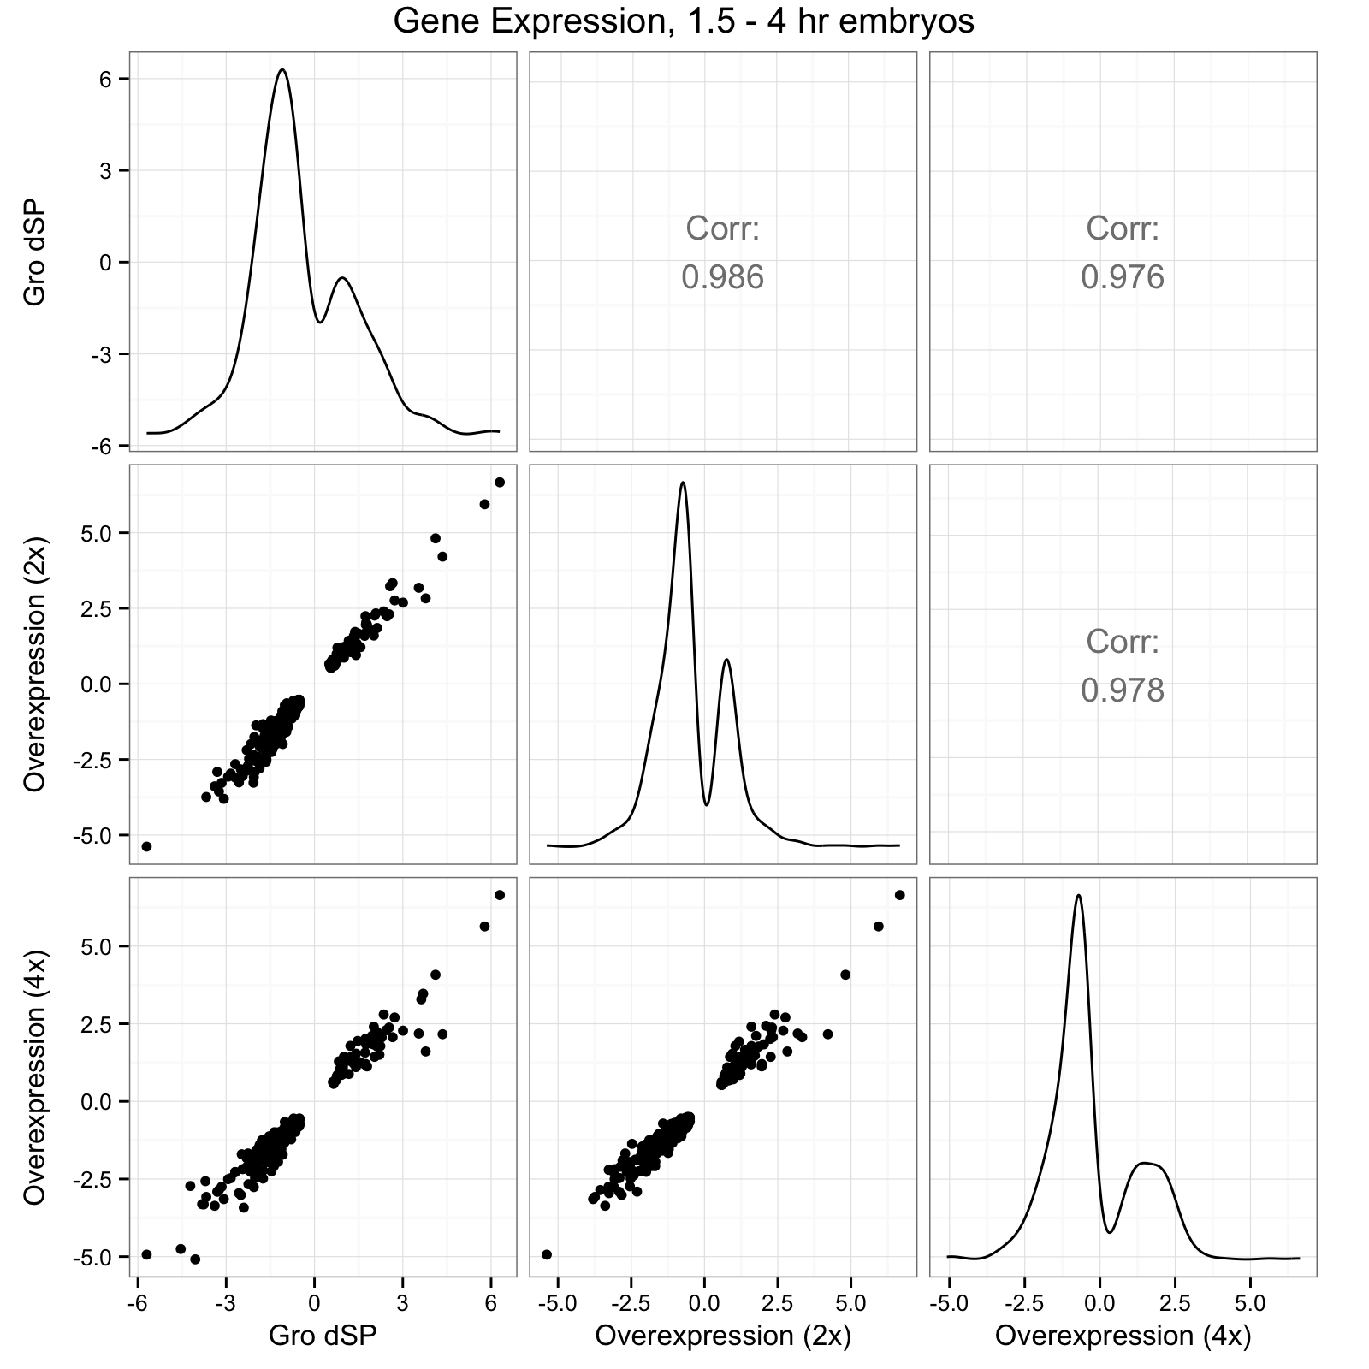
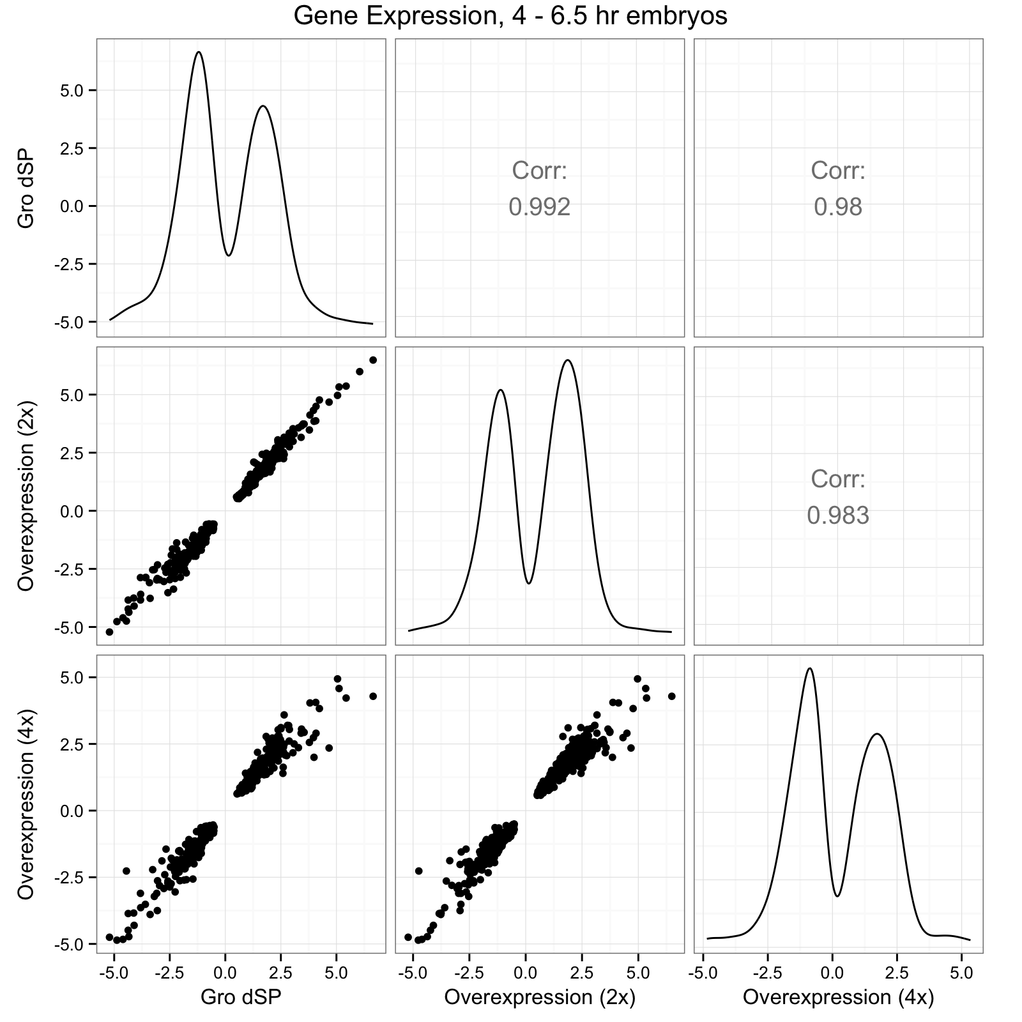
Fig. 2-17
A
B

Slide 17
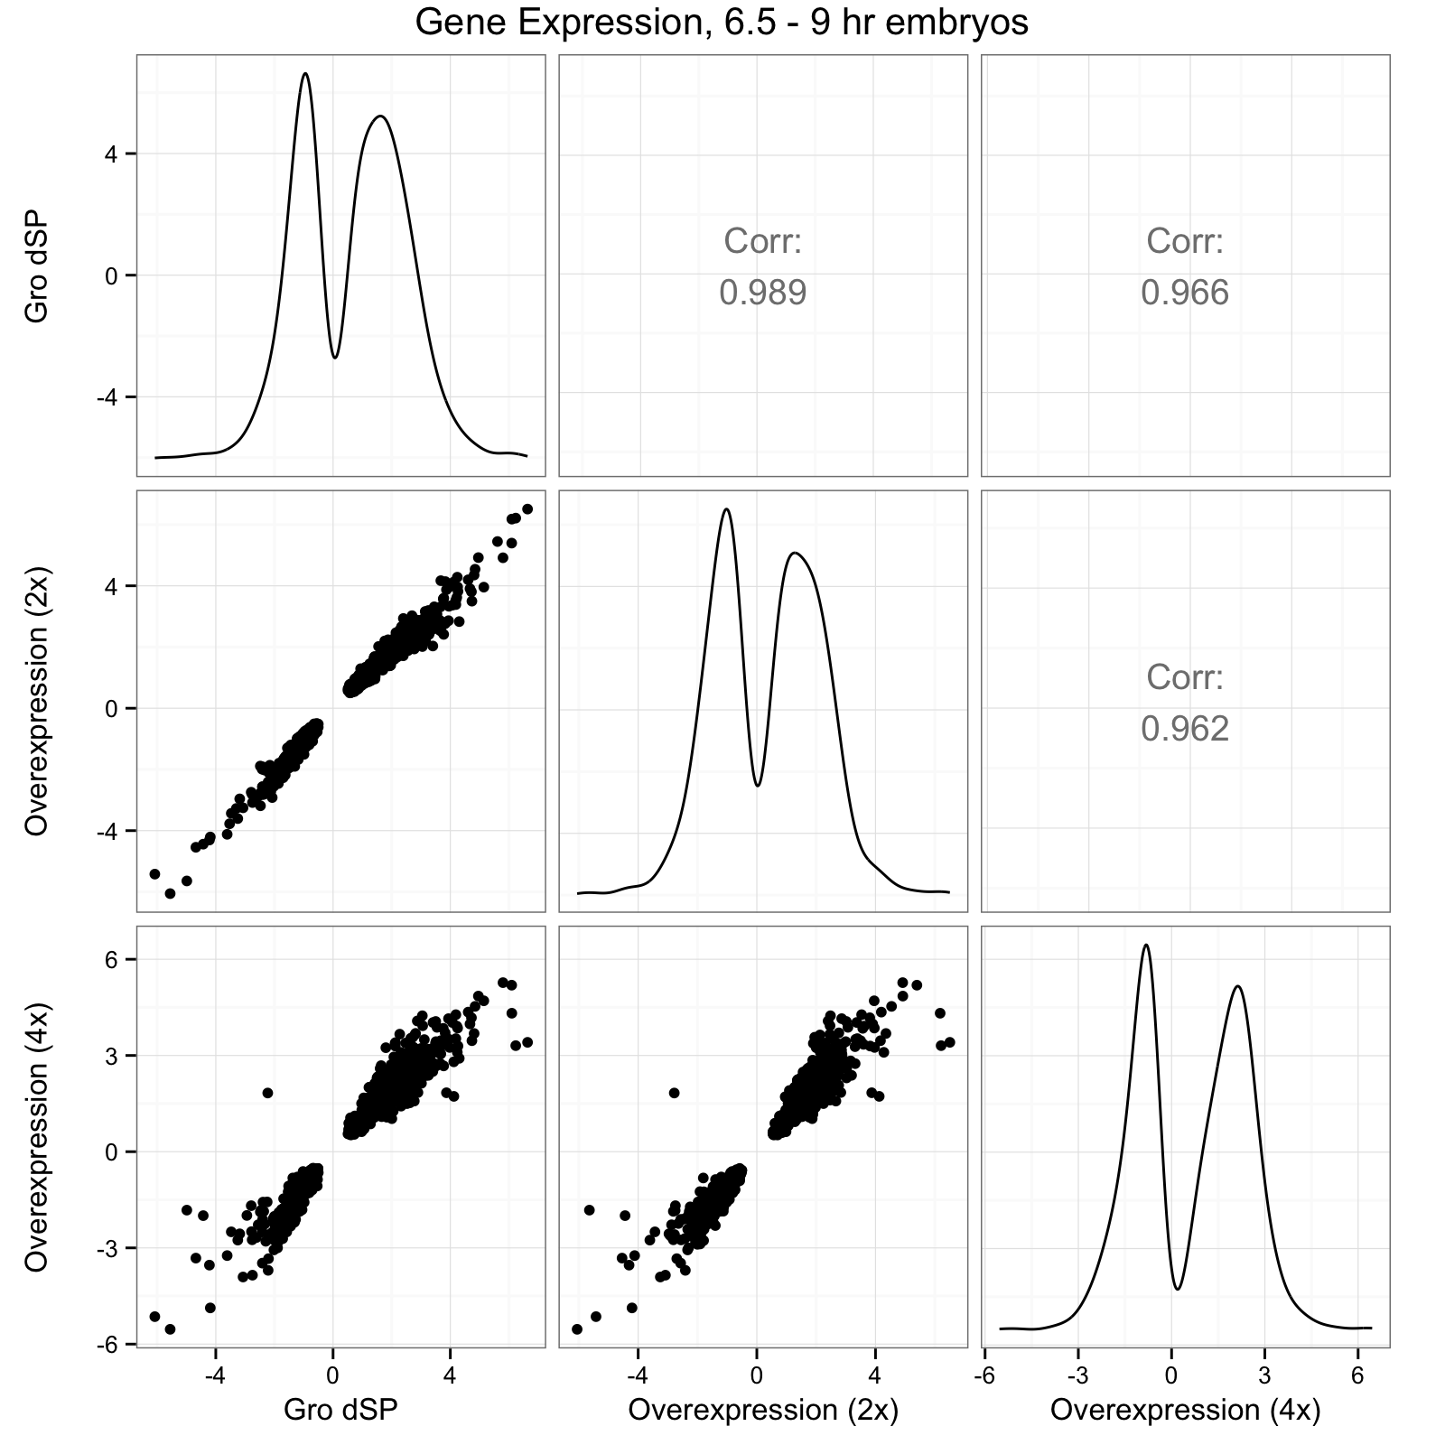
Fig. 2-17 (continued)
C

Slide 18
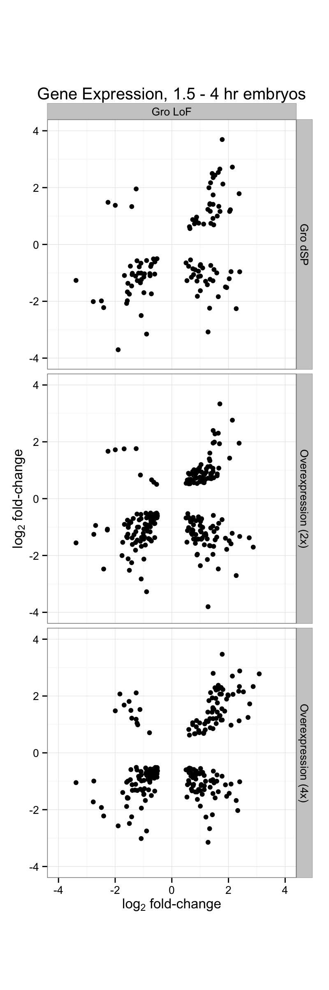
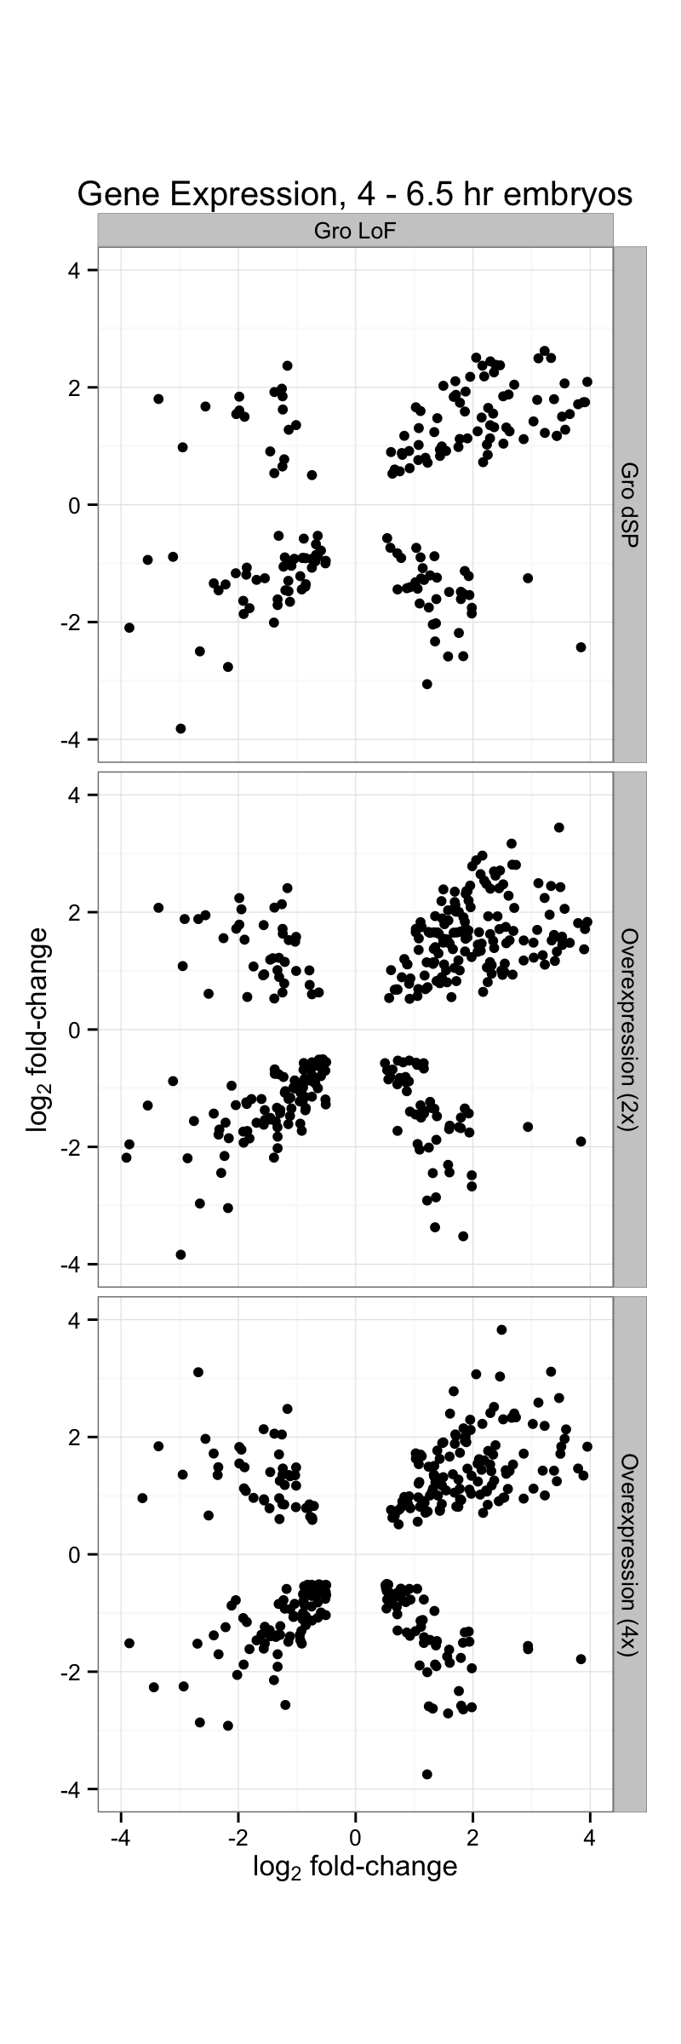
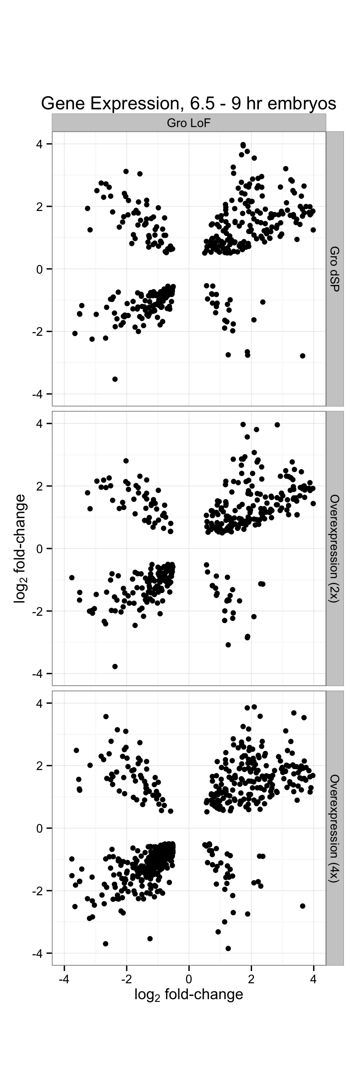
Fig. 2-18

Slide 19
Fig. 2-19
Gro loss-of-function
vs.
2x Gro Overexpression
Gro loss-of-function
vs.
4x Gro Overexpression

Slide 20
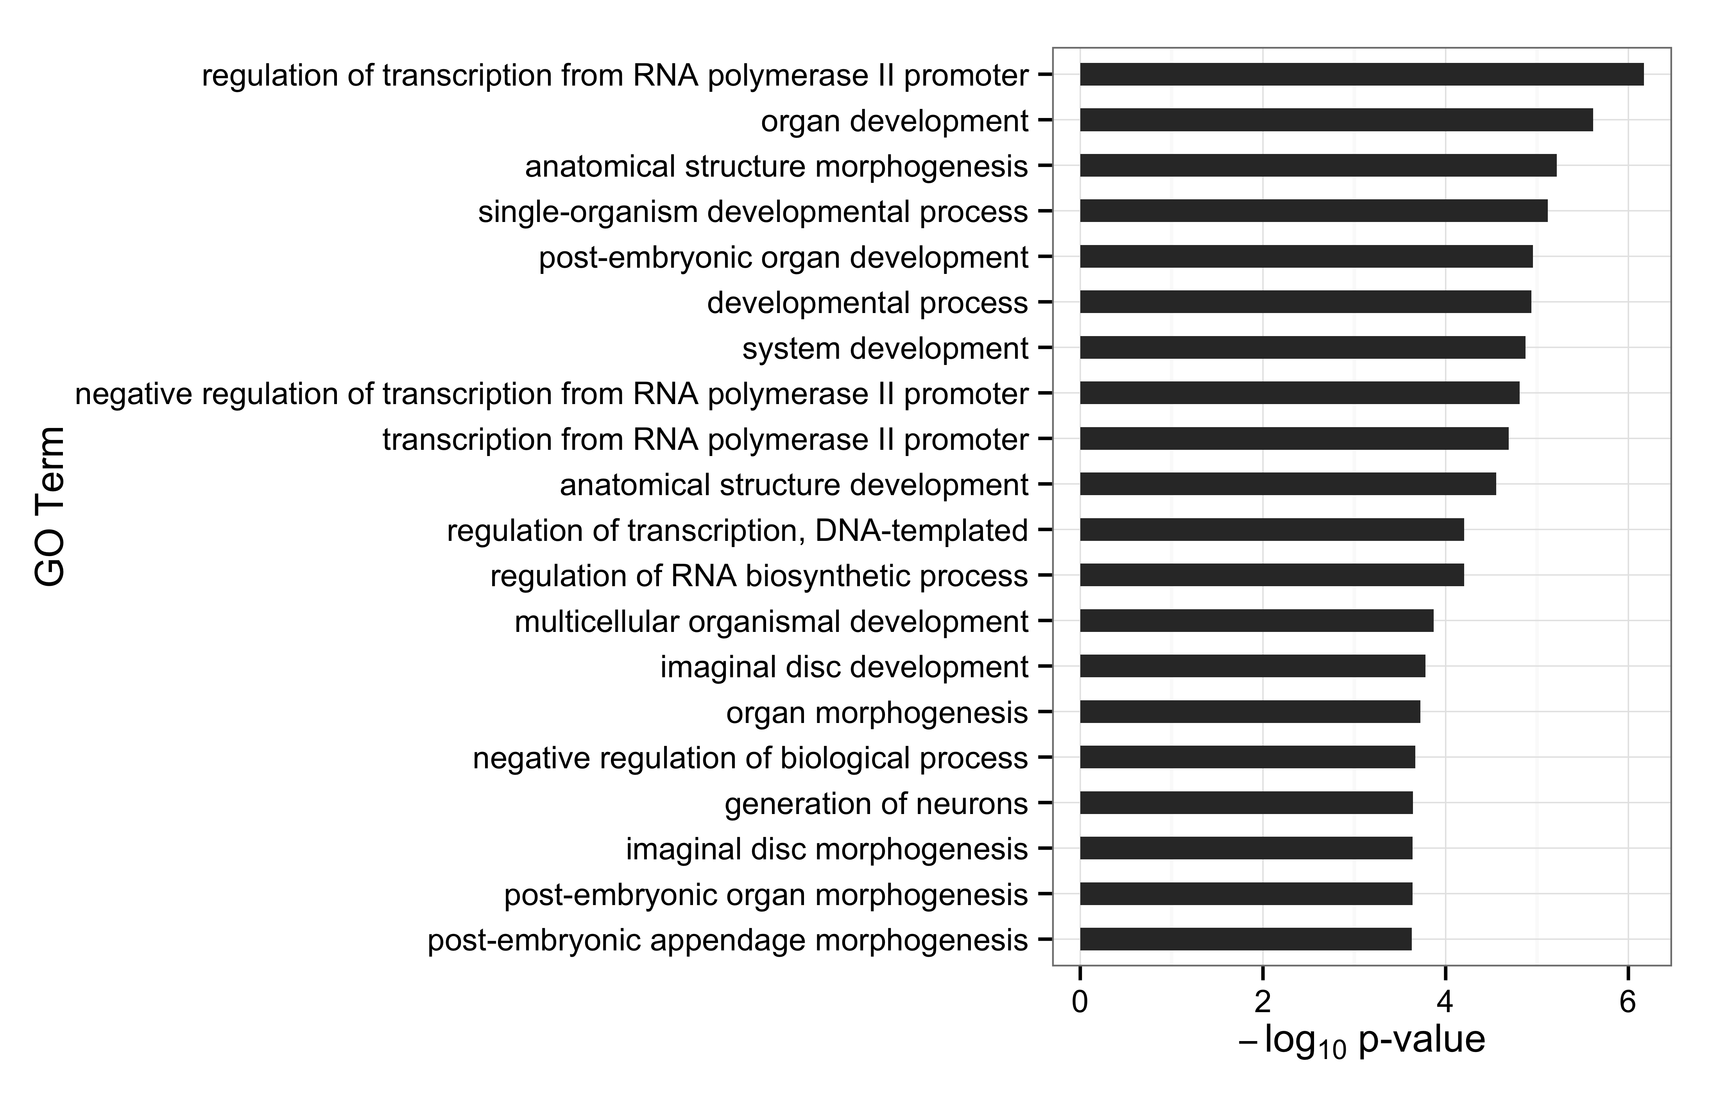
Fig. 2-20

Slide 21
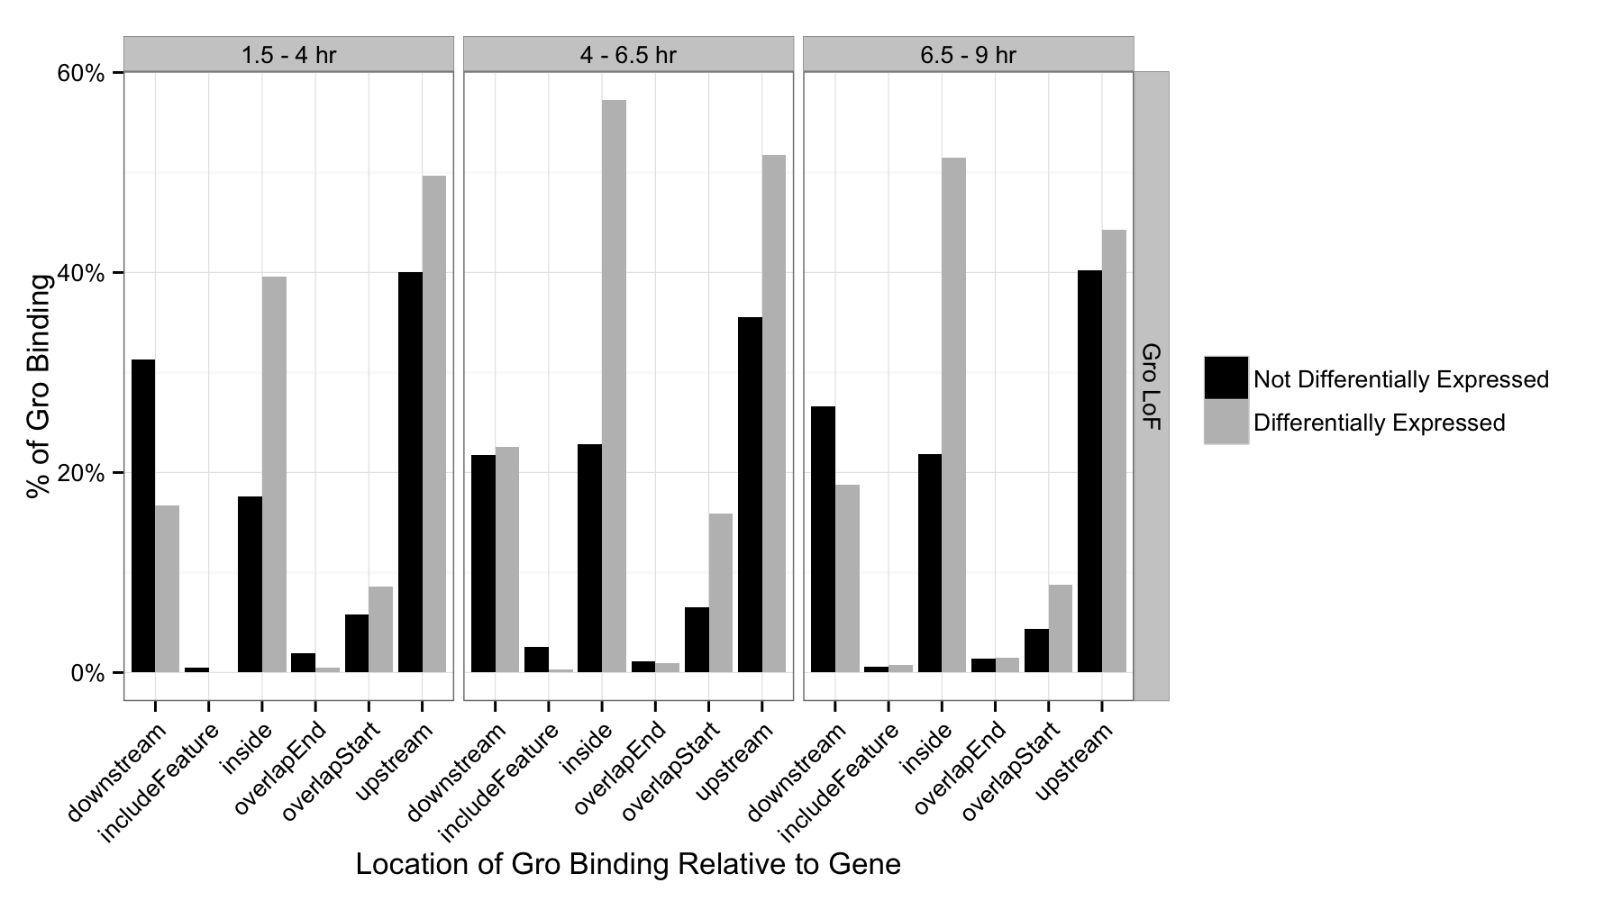
Fig. 2-21
Percentage of genes with internal Groucho binding

Slide 22
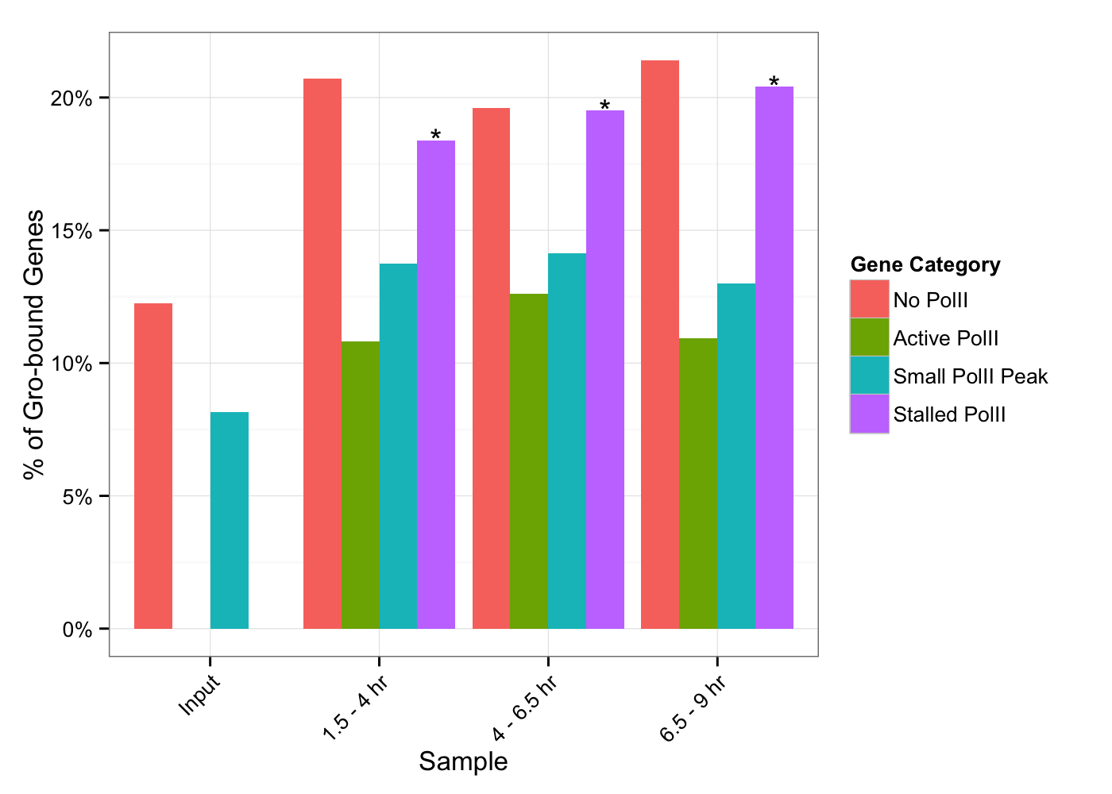
Fig. 2-22

Slide 23
Fig. 2-
z-score
Anterior-posterior
Dorsal-ventral
1.5 – 4 hr
4 – 6.5 hr
6.5 - 9 hr

Slide 24
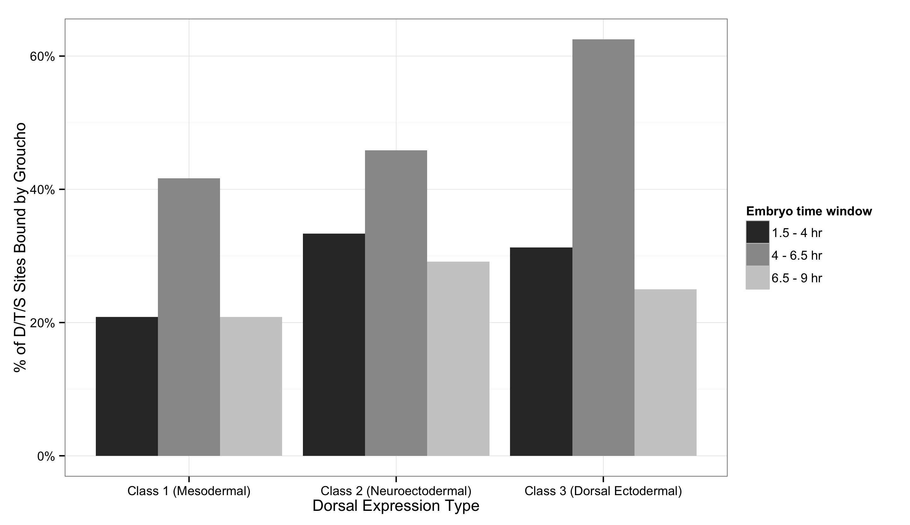
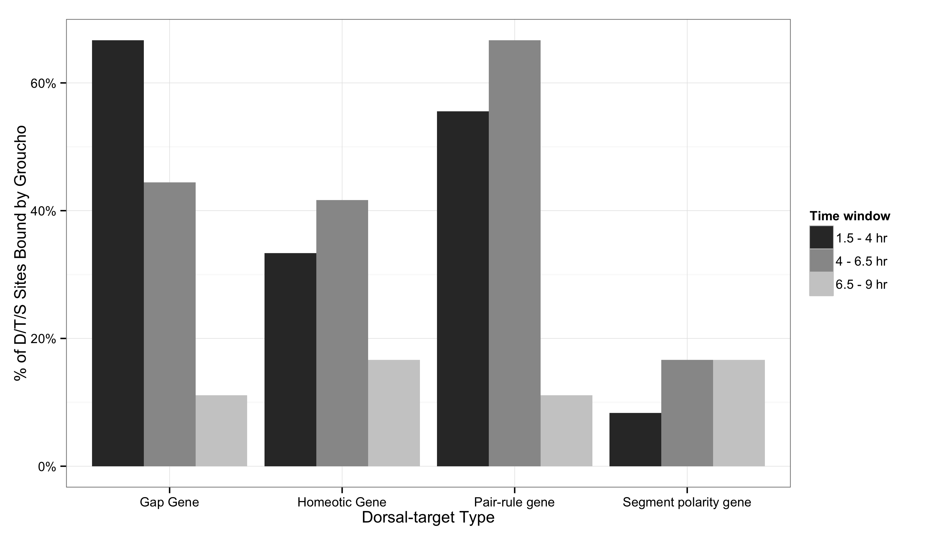
Fig. 2-

Slide 25
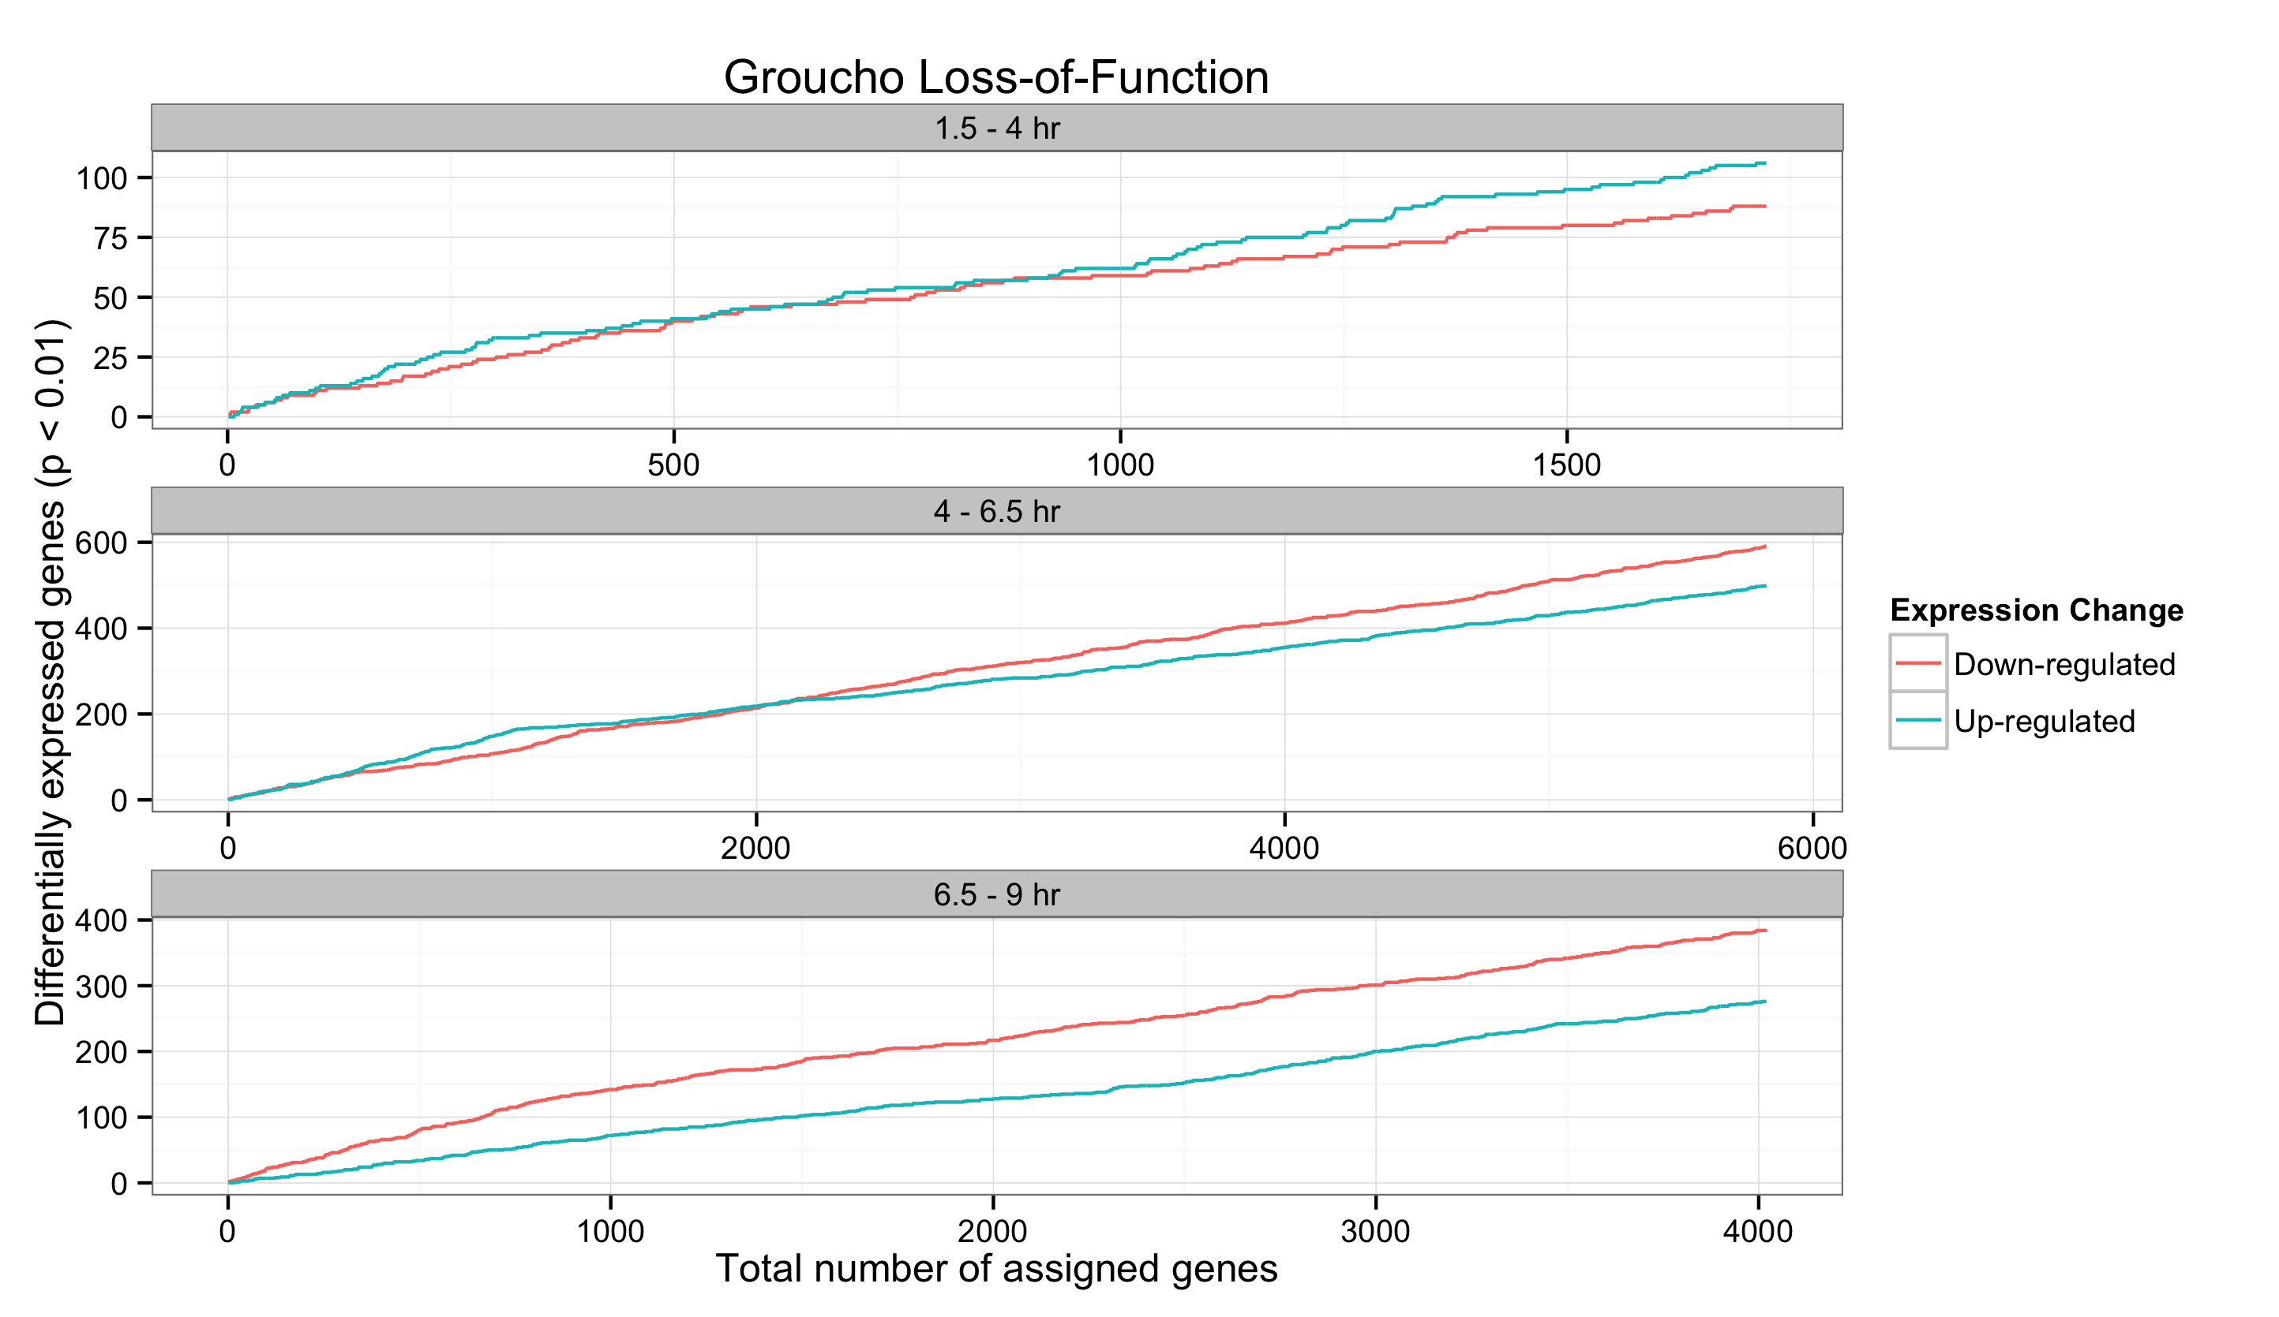
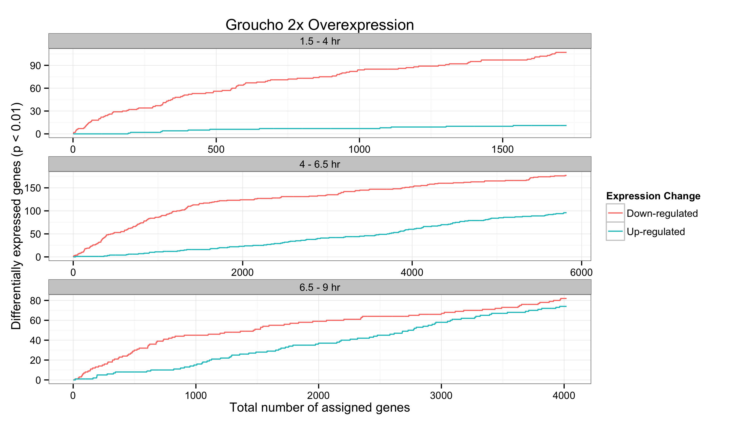
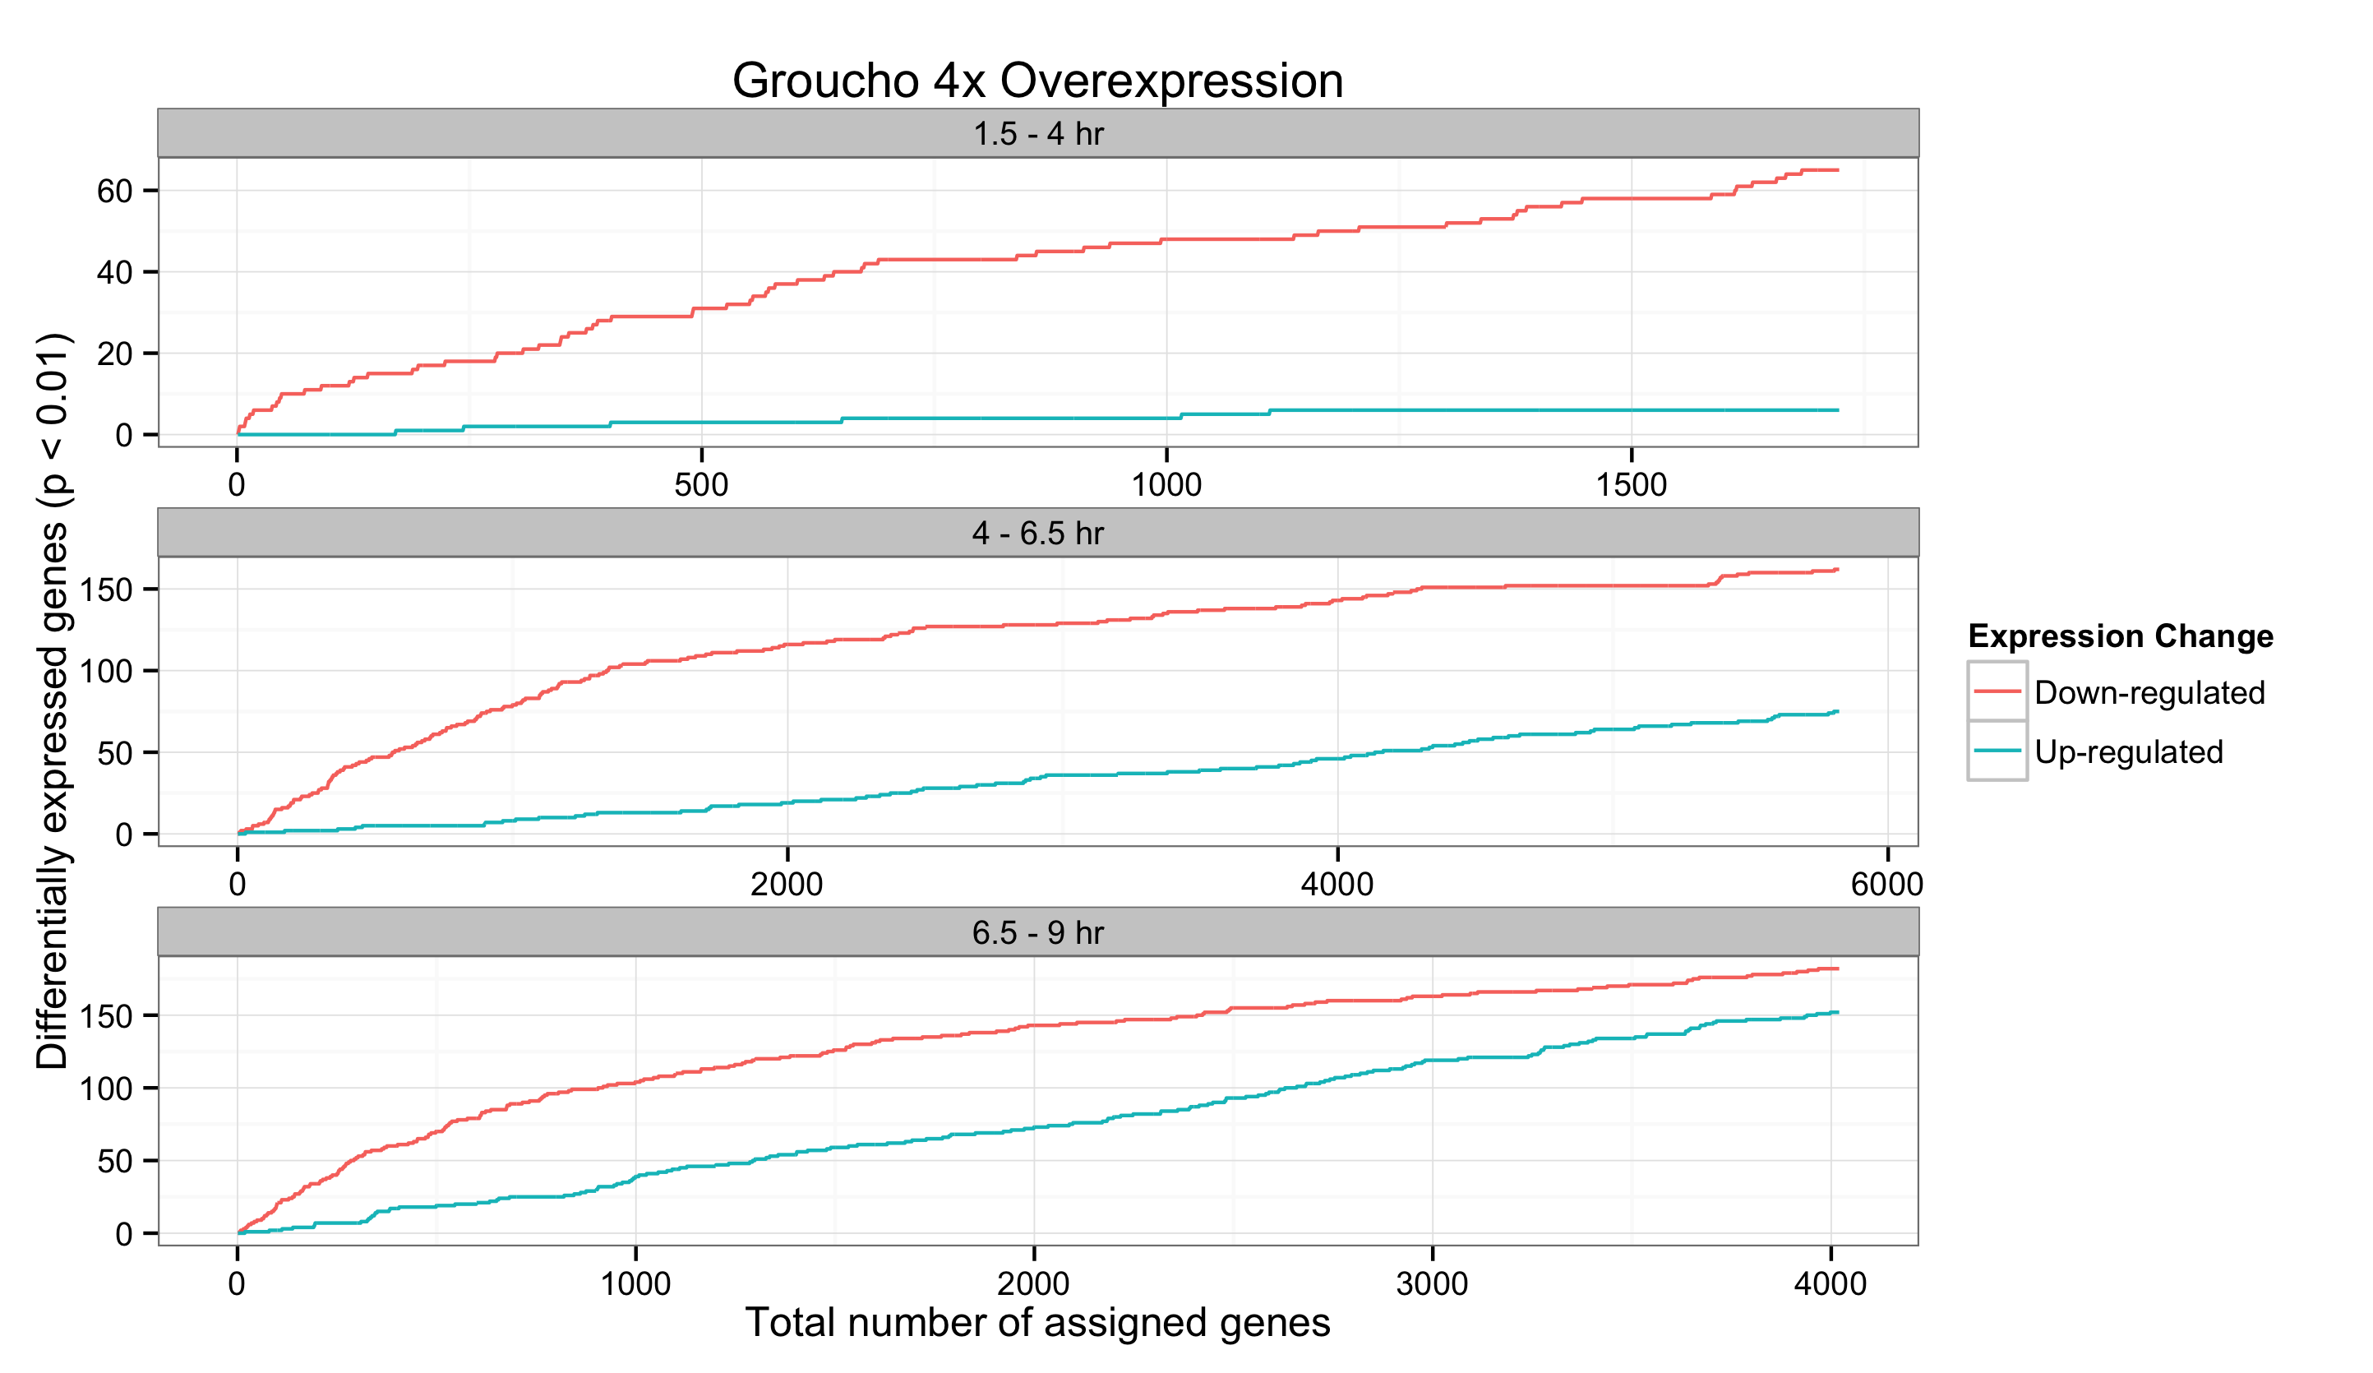
Fig. 2-

